Slide 1
15th Conference of the South West Pacific Hydrographic Commission 21-22 February 2018 Nadi, Fiji
Satellite derived bathymetry (SDB)
IRCC actions &
SDB seminar in Ottawa – 18-20 sept 18

Slide 2
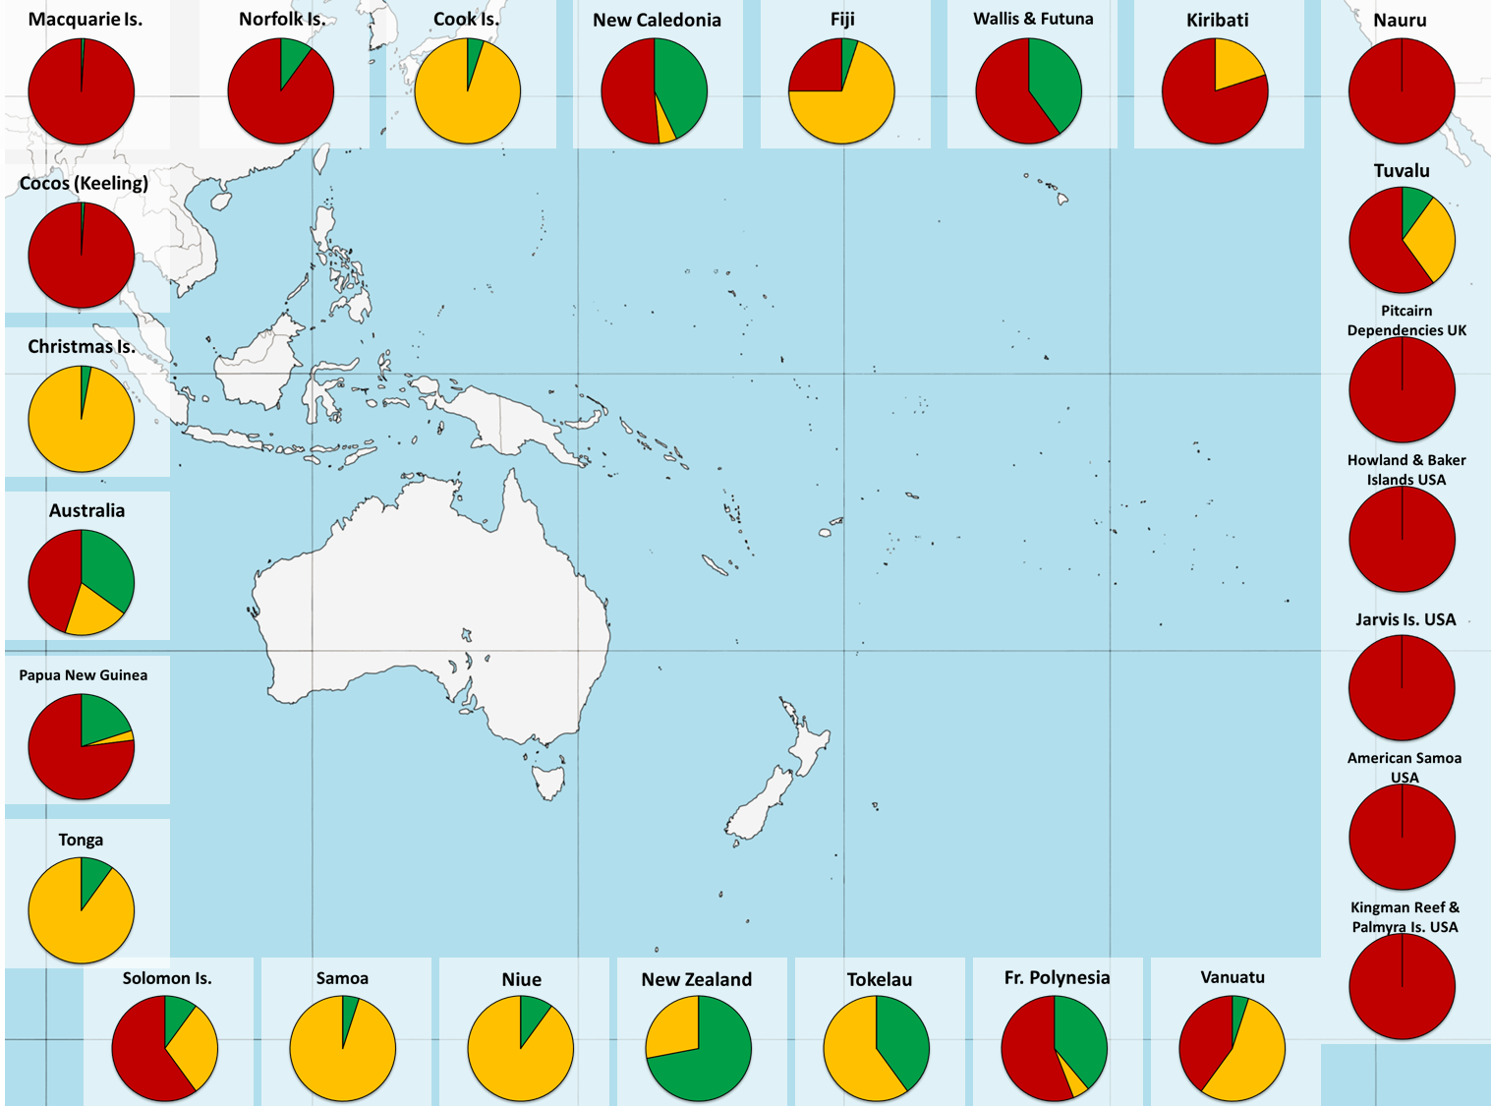
15th South West Pacific Hydrographic Commission Conference
Satellite derived bathymetry
Vast areas with a poor knowledge
Concerns most of the SWPHC area !
C-55 state of survey – Shallow waters
(0-200m)

Slide 3
15th Conference of the South West Pacific Hydrographic Commission
Satellite derived bathymetry
DECISION OF THE 1st SESSION OF THE IHO ASSEMBLY
Notes:
Proposal 5 - submitted by Canada, France and USA to IHO AG1 in April 2017
DEVELOPMENT OF AN IHO SATELLITE DERIVED BATHYMETRY ASSESSMENT AND CHARTING PROGRAMME
FOR AS YET UNCHARTED OR POORLY CHARTED AREAS

Slide 4
15th Conference of the South West Pacific Hydrographic Commission
Satellite derived bathymetry
IRCC9 (June 2017) report : actions 32 - 33 - 34
RHCs to encourage MS:
- using SDB and risk assessment methodologies to report back to IRCC 10
- to participate to the workshop sponsored by Canada in 2018

Slide 5
15th Conference of the South West Pacific Hydrographic Commission
Satellite derived bathymetry
SDB Seminar in Ottawa (CHS, NOAA & Shom)
18-20 September 2018
Open to all HOs, industry, academia
Objective
Share the international expertise to advance Hydrographic Remote Sensing (HRS) by discussing the status of present HRS technologies, its geospatial/hydrospatial applications and impacts of emerging new HRS technologies.

Slide 6
15th Conference of the South West Pacific Hydrographic Commission
Satellite derived bathymetry
SDB Seminar in Ottawa
Expected themes
Day 1 (September 18, 2018)
– HRS in support of planning, monitoring, risk assessment
Day 2 (September 19, 2018)
– HRS Hydrospatial applications and services
Day 3 (September 20, 2018)
– HRS Emerging technology, solutions, sensors and missions
Notes:
Day 1 (September 18, 2018) – HRS in support of planning, monitoring, risk assessment:
Water Clarity monitoring for Lidar planning
HRS as reconnaissance survey tool
Natural disaster recovery, survey planning
Change Detection (bathymetry, shoreline)
Chart adequacy analysis
Day 2 (September 19, 2018) – HRS Hydrospatial applications and services:
Integration of Satellite Derived Bathymetry on navigation products
Chart representation and standards (S-44 / S-57 / S-100)
HRS process inclusion in traditional Hydrographic offices workflows
Potential collaborations, joint initiatives, capacity development.
Day 3 (September 20, 2018) – HRS Emerging technology, solutions, sensors and missions:
Existing and emerging technologies which can be leveraged for HRS purposes.
Potential and limitations of existing sensor technologies in terms of data accuracy, precision, and their suitability in various applications.
Expected technological advances and their impact on HRS.

Slide 7
Thank you

Slide 8
15th Conference of the South West Pacific Hydrographic Commission 21-22 February 2018 Nadi, Fiji
Study for the implementation of a high-resolution image satellite
reception facility in New-Caledonia
Information – New Caledonia government initiative

Slide 9
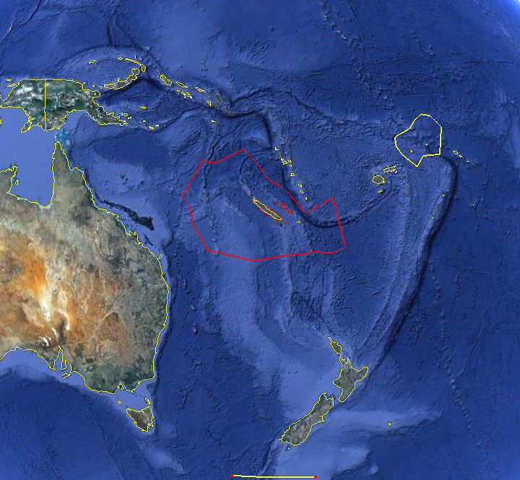
Satellite reception facility - Line of sight - benefits
EEZ
Fisheries monitoring and surveillance
including illegal fisheries
Pollution monitoring
POLMAR operations
Natural disasters (tsunamis, cyclones, eathquakes …
Humanitarian operations
planning
impacts
Tokelau, Tuvalu,
South Kiribati, Nauru
East PNG,
Solomon
MILITARY MARITIME INTELLIGENCE AREAS
Civilian population evacuation operation and planning
Fight against terrorism
Illegal immigration
Fight against trafficking of all kinds : arms and drugs
Vanuatu
Fiji
Samoa, American Samoa, Tonga,
Niue
Nouméa
East Australia
SAVE & RESCUE ZONE
Search operations at sea
Rescue operations planning at sea
MAPPING/ENVIRONMENT
Preparation of hydrographic charts (bottom types, first bathymetric evaluation..)
Coral reefs (3 main coral reefs formations in the world),
Mangroves and marshes…
Shoreline evolution
Sea level rise
New-Zealand
Visibility circle (Nouméa station)
5.000 km diameter

Slide 10
Feasibility study ongoing
- NC is eager to mutualize effort and participation for success
- NC launched a pre-study to estimate interests and expected benefits
- Questionnaire sent to nations by the study team
- Will be resent by email to SWPHC contact list
- Contact : Lionel.Loubersac@outlook.fr

