Slide 1
IALA World –Wide Academy
Briefing to SWPHC Workshop on the Quality of Maritime Management in the Pacific Region

Slide 2
IALA Strategic Vision and Goals for 2026
Goal 1
Ensure that aids to navigation systems and related services, including e-Navigation, Vessel Traffic Services, and emerging technologies, are harmonized through international cooperation and the provision of standards.
Goal 2
All coastal states have contributed to an efficient global network of aids to navigation and services for the safety of navigation, through capacity building and the sharing of expertise.

Slide 3
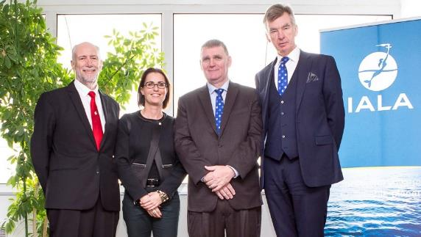
The World-Wide Academy
Functions:
1. Education and training
2. Capacity building, and
3. Research and development
Inaugurated January 2012
Independently funded

Slide 4
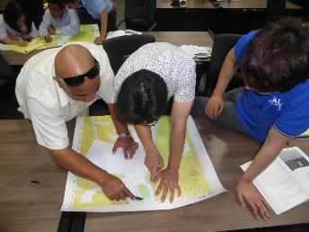
Capacity Building
Capacity Building is the development and strengthening of human and institutional resources.
AtoN Competent Authorities in developing countries are obliged to deliver AtoN services, but sometime lack the capacity to do so. The Academy actively facilitates that process through technical missions and training events, working closely with its Partners such as the IHO, LINZ and SPC

Slide 5
International Obligations: SOLAS V Regulation 13
Chapter V Regulation 13.1 requires a Contracting Government to provide “as it deems practical and necessary” by itself or with other Governments “such AtoN as the volume of traffic justifies and the degree of risk requires”
IALA Risk Management Toolbox endorsed by IMO in SN.1/Circ.296
Ch V Reg 13.2: AtoN should conform to international standards (IALA recommendations and guidelines)
Ch V Reg 13.3 information about AtoN must be given to all concerned (mariners; stakeholders etc.)

Slide 6
Responsibility for AtoN
The Competent Authority (CA) provides or formally delegates the provision of its AtoN service to States; Territories; local government; ports, harbours and waterways; military organisations or private groups
The geographical area of each must be defined
Responsibility for the AtoN service remains with the Government not with the service provider
Ensure that national maritime law specifies which Ministry is the CA and that the CA has the right to audit all AtoN service providers

Slide 7
Obligations of the Competent Authority of a Contracting Government to SOLAS
Provide as many AtoN are required based on a risk assessment
Guarantee the reliability of each AtoN
Update the AtoN service as maritime traffic, environmental patterns, technology and resources change
Set up a formal method of informing all concerned including mariners about existing AtoN, new AtoN, and AtoN failures (charts; nautical publications; NAVTEX etc.)
Decide who will provide the AtoN service

Slide 8
Volume of Traffic in the SW Pacific Region

Slide 9
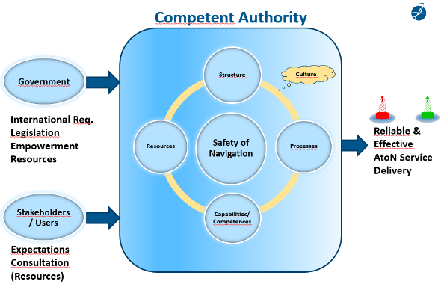
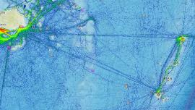
Volume of Traffic and Degree of Risk
Maritime Management Quality

Slide 10
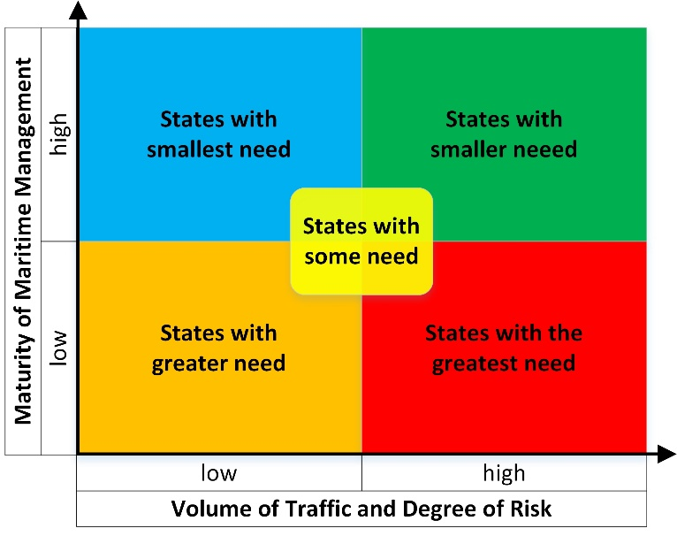
The
The Higher the “Score” the greater the need

Slide 11
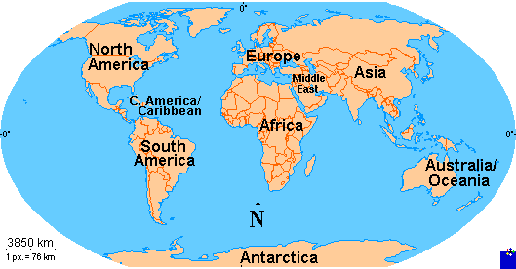
Priority 1 States – Score of 57 or more
Pacific Region
Priority | No. of States | Score
1 | 0 | 57+
2 | 4 | 48 - 56
3 | 2 | 45 - 47

Slide 12
Accredited Training Organizations (ATO)
France *2
Canada
China
Korea *2
Malaysia
Oman
Portugal
Spain
Suriname
Ukraine
UAE
Argentina
India
South Africa
Morocco

Slide 13
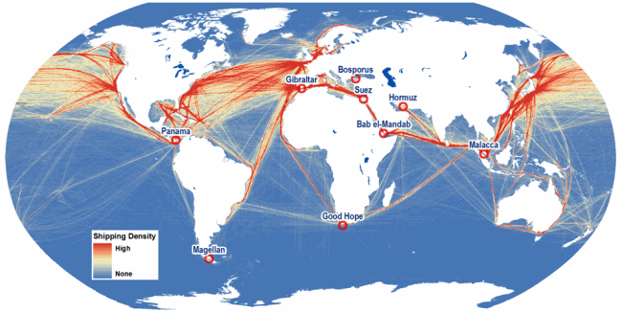
Traffic Density and States in Need

Slide 14
Competent Authority
Safety of Navigation
Structure
Processes
Capabilities/ Competences
Resources
Government
Culture
International Req.
Legislation Empowerment
Resources
Reliable & Effective AtoN Service Delivery
Issues:
Maritime legislation
Structure / Organization
AtoN Availability
Risk Management skills
National AtoN Register
Maritime Safety Information
User Consultancy
Competences
AtoN Maintenance
Stakeholders / Users
Expectations Consultation
(Resources)

Slide 15
Analysis of Technical Missions
30 Missions since 2013
1,292 Recommendations
Greatest shortcoming – poor MSI
Category | Number
MSI | 101
Maritime Legislation | 70
AtoN upgrades | 68
Improved organisation | 64
Risk analysis | 55
AtoN manager training | 48
AIS enhancement | 48

Slide 16
New Simplified Risk Tool
Simplified IALA Risk Assessment - SIRA

Slide 17
The SIRA Concept (IALA GL 1018)
Risk is the product of two factors; probability and consequence
Risk management uses a process to identify hazards and unwanted scenarios in a specified waterway before taking action to reduce risk to a level acceptable to stakeholders which is As Low as Reasonably Practicable – ALARP
A fundamental relationship exists between hazards and the consequences of undesirable incidents which hazards may cause
Hazard
Unwanted scenario
Short or long-term Consequences
Causal Relationship

Slide 18
Risk Value Matrix (G1138 Table 3)
 |  | PROBABILITY OR LIKELIHOOD
 |  | Very Rare (1) | Rare (2) | Occasional (3) | Frequent (4) | Very frequent (5)
CONSEQUENCE OR IMPACT | Catastrophic (5) | 5 | 10 | 15 | 20 | 25
 | Major (4) | 4 | 8 | 12 | 16 | 20
 | Severe (3) | 3 | 6 | 9 | 12 | 15
 | Minor (2) | 2 | 4 | 6 | 8 | 10
 | Insignificant (1) | 1 | 2 | 3 | 4 | 5

Slide 19
Probability and Impact Scores 1 – 5 GL G1138.4.5
Proposed criteria scores for probability and impact in the GL are not “set in stone”
It must be for the CA to determine the most appropriate criteria for the task to be addressed
Minor = 2
Minor injury | Financial loss $1,000 - $50,000 | Limited environmental damage
5 injured people | $10,000 - $100,000 | PSSA not affected

Slide 20
Risk Control Options (RCO)
RCO for each undesirable incident reduce the risk to a level (As Low As Reasonably Practicable - ALARP) which is acceptable to stakeholders
The Risk Value will determine what action is required (G1138 Table 4)
Risk Value | Risk Category | Action Required
1 - 4 | Green | Low risk. No RCOs unless implemented at low cost
5 - 8 | Yellow | Moderate risk. Reduce to ALARP level through RCOs
9 - 12 | Amber | High risk requiring RCO and significant funding
15 - 25 | Red | Very high and unacceptable risk – immediate action required with major funding. Ports/waterways may need to close until risks are at ALARP level

Slide 21
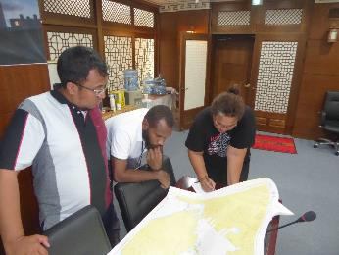
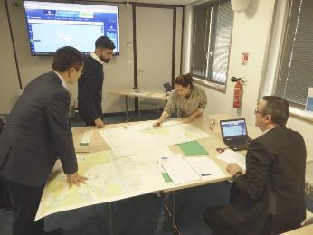
Training 2018 – new syllabus L1.1
Level 1 AtoN Manager Course
Includes SIRA training
In English: China, Suriname, India, South Africa, Malaysia,
In French: France, Morocco
In Spanish: Ecuador

Slide 22
Thank you
Contact: stephen.bennett@iala-aism.org

