Slide 1
15th South West Pacific Hydrographic Commission Technical Workshop 20th February 2018 Nadi, Fiji Islands
FIJI HYDROGRAPHIC OFFICE BRIEF
Lieutenant Jervis Robinson
Senior Hydrographic Surveyor
Fiji Hydrographic Office

Slide 2
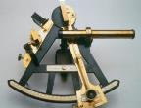
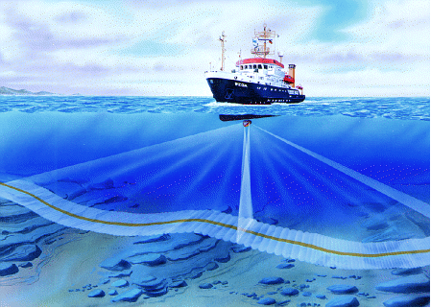
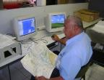
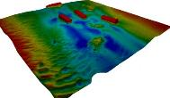
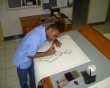
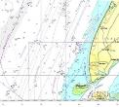
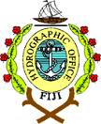
Contents
FHO Overview
Projects
Constraints
Questions

Slide 3
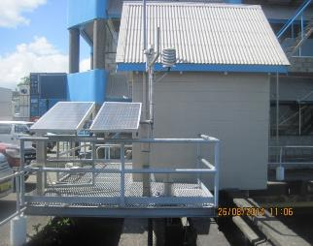
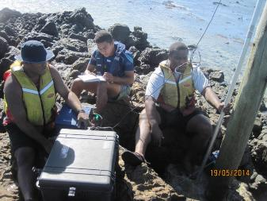
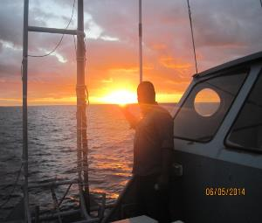
FHO OVERVIEW

Slide 4
Roles & Responsibilities
To collect with systematic surveys at sea and along the coast geo -referenced data related to:
Aids to navigation and port survey updates
Depths of the area encompassed within Fiji’s EEZ and of national interest
Sea bottom composition
Tides and currents
Physical properties of water column
Magnetic properties of the oceanic earths crust within Fiji waters
2. To process the information collected in order to create organized databases capable of feeding the production of thematic maps, nautical charts and other types of documentation for the following most common uses:
Maritime navigation and traffic control
Naval operations
Notes:
To provide Hydrographic services for navigable waters within Fiji’s National Area of Responsibility as required by the United Nations Safety of Life at Sea (SOLAS) Convention.

Slide 5
Roles & Responsibilities
Coastal Zone management and defence
Marine environment preservation
Exploitation of marine resources and laying of submarine cables/pipelines
Maritime boundaries delimitation(Law of the Sea implementation)
Scientific studies connected to the sea and near – shore zone
3. To update databases through:
Re-survey when and where needed
Gathering supplementary information from other maritime authorities.
4. To ensure the:
Production, distribution and updating of nautical charts and publications
5. To ensure the timely dissemination of marine safety information
Notes:
To provide Hydrographic services for navigable waters within Fiji’s National Area of Responsibility as required by the United Nations Safety of Life at Sea (SOLAS) Convention.

Slide 6
Products and Services
Hydrographic and Oceanographic Surveys
Nautical Charts
Navigational Charts
Special Charts (showing 200 Mile EEZ and Maritime Baselines)
Hydrographic Publications:
Fiji Nautical Almanac (published annually)
Fiji Chart Catalogue
Maritime Safety Information:
Fiji Notices to Mariners (periodical)
Fiji Coastal Navigational Warning (MSAF)
Nautical information (at the request of customer)
Historical Archive research
Notes:
Products and services provided by FHS are as follows:

Slide 7
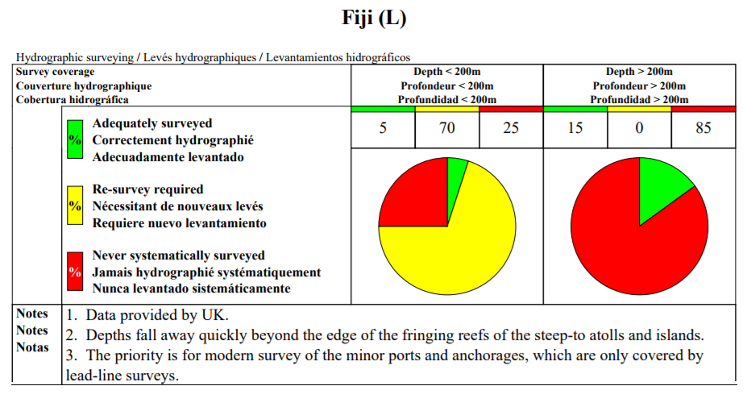
Status of Nautical Charts
Coverage of Hydrographic Surveying at Depths <200m / >200m (IHO Publication C55 23 Aug. 17)
Notes:
Products and services provided by FHS are as follows:

Slide 8
FHO Current Strength
Category | No.
Category A Hydrography | 3
Category B Hydrography | 4
Category B Marine/Nautical Cartography | 4
PO “Q” – Diploma Hydrography | 2
Basic Hydrography | 3
Under Trainees | 3

Slide 9
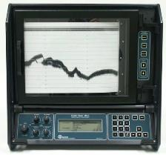
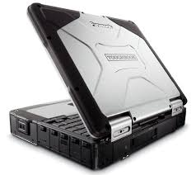
Equipments
Data Acquisition
02 x R2Sonic MBES
Odom MK III SBES together with a Side Scan Transducer
Thales Differential GPS
Trimble SPS DGPS
Acquisition software and processing

Slide 10
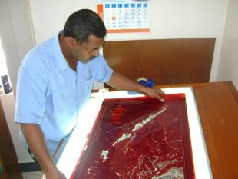
Cartography (Charting)
Status
FHO currently has a catalogue of 15 navigational charts to IHO Standards.
Special Charts 3 (Fiji Marine Spaces and EEZ Chart)
Printer Nation for 03 INT Charts
The last set of charts was published in 1999
Continue to Maintain and update to NtMs
Number of charts published to date | 18
Notes:
Explain process of chart production (printing problems)
Need for a new chart to be produced
Maintenance of charts
Up to date survey data required.

Slide 11
FHO also publishes the annual Fiji Nautical Almanac.
Contains tidal prediction data for Standard Port (Suva)
Astronomical Data
Fiji list of lights (K)
Port of entry information
Assist in the compilation, promulgation and distribution of Maritime Safety Information (MSI).
Fiji Notices to Mariners
Admiralty, AUS & NZ Notices to Mariners
Fiji Coastal Navigational Warnings
NAVAREA XIV Warnings

Slide 12
Developments
Introduction of Digital Chart Production System (2015)
FHO uses the Teledyne CARIS Software Package;
Base Editor - Analyse and compile processed bathymetry data
Paper Chart Composer - Produce and maintain INT1 / INT2 compliant paper charts and raster chart outputs including BSB-format RNCs
S57 Composer - Produce and maintain S-57 products (ENC,AML,IENC) and in the future S-100 / S-101 products.
Publications Module - Produce and maintain nautical publications including NtMs and List of Lights.
Have received CARIS certified training in all modules

Slide 13
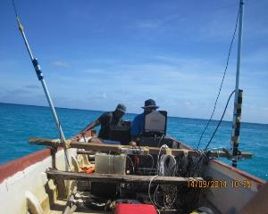
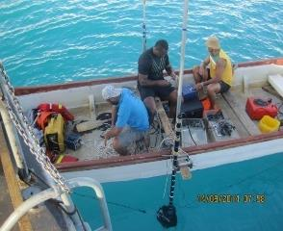
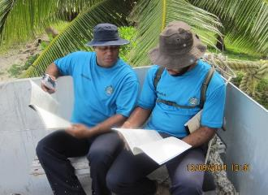
Projects
Completion of chart INT747 – Yasawa/Mamanuca Group
Recompilation of Special charts (FMS)
Developing a Vector database of all Fiji Chart Folio
Final Checks to F13 – Rovodrau Bay
Approaches to Savusavu – Valaga Bay

Slide 14
Capacity Building
Training in Hydrography and Nautical Cartography is not available locally
FHO dependant on overseas courses
Previous/Current training are sourced from
Introduction of cross training for all officers
Course | Country
Marine Cartography and MSI | UK, Japan, NZ, Singapore
Hydrography | Japan, India, Australia, Pakistan, NZ, SPC
Oceanography | South Korea

Slide 15
FHO & KHOA Official Development Project
1st ROK-Fiji bilateral meeting held on August 28, 2014.
Feasibility study conducted and proposal submitted.
Approval granted in 2015 with commencement beginning 2016 through to 2020.
Purpose of Project
To assist Fiji in strengthening its Marine Scientific Research Capability and present roles in contributing to national infrastructure.
To support safe and efficient seaways, facilitate the protection of marine environment, to support the administration of sustainable development of national maritime zones.

Slide 16
FHO & KHOA Official Development Project
Provision of professional Hydrographers and other personnel to participate in the planning and execution of ODA project on Oceanographic and hydrographic Operations;
Provision of technical materials, equipment and data acquisition and processing systems;
Provision of technical support;
Provision of technical training in ROK.

Slide 17
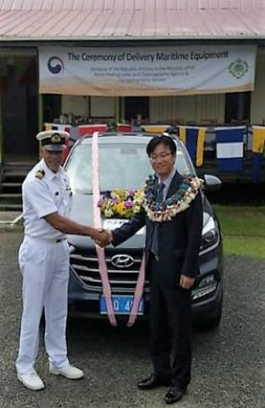
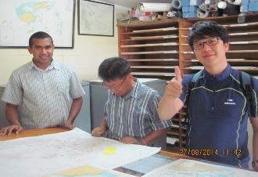
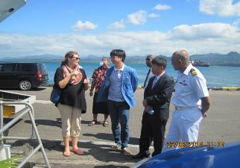
FHO & KHOA Official Development Project
2016 ODA Project:
01 x 4WD Hyundai Tucson
6m Aluminum SMB with accessories
01 x SMB Trailer
Tide gauge equipment
Oceanography Training 2 officers (S/Korea)
Conducted 2 weeks in-house training on DCP

Slide 18
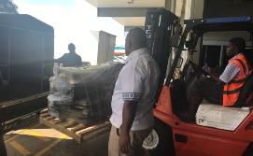
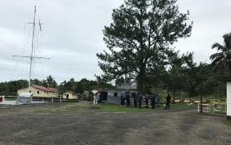
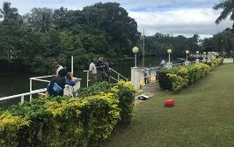
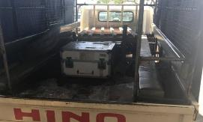
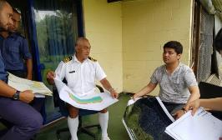
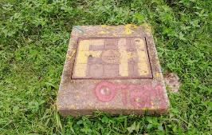
FHO & KHOA Official Development Project
ODA Project 2017:
MBES Handover
Joint Survey – Rovodrau Bay, Pacific Harbor
Data Processing Training - ROK

Slide 19
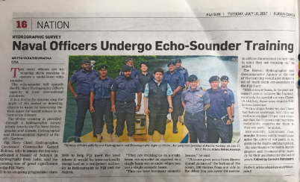
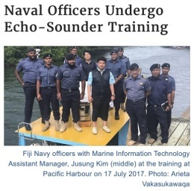
FHO & KHOA Official Development Project
Proposed Submissions for Aid
Ocean Research Vessel
MBES
SSS
ADCP
Water Column Analysis Equipment
Sub bottom profiler
Magnetometer
Geodetic GPS with processing software

Slide 20
FHO & KHOA Official Development Project
Proposed Submissions for Aid
Education and Training
Cat B & Cat A Hydrographic Training
Cartography Training
Equipment
04 x Trimble Geodetic GPS Sets
Ceescope Portable SBES
01 x Trimble S4 Total Station
ARC GIS License

Slide 21
Current Difficulties Being Faced
Constraints
Solutions
Survey vessel
Replacement of equipment
Equipment to conduct survey
Unavailability of offset printing for F charts
Concept of Deployable Geospatial Teams
Proper equipment replacement plan in budget submission
Procurement of survey equipment
Contract for digitization of existing chart folio

Slide 22
Problems
Solutions
Survey vessel
Replacement of equipment
Equipment to conduct survey
Unavailability of offset printing for F chart folio
Current strength to operational area ratio
Concept of Deployable Geospatial Teams
Proper equipment replacement plan in budget submission
Procurement of survey vessel and equipment
Contract for digitization of existing chart folio
Restructure of FHO

Slide 23
QUESTIONS?

