Slide 1
16th Meeting of the South West Pacific Hydrographic Commission National Report by
New Zealand

Slide 2
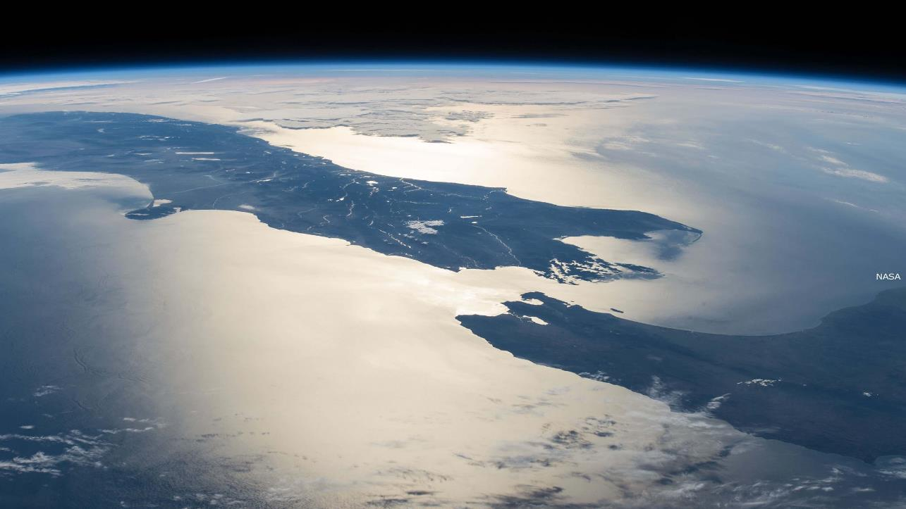
Main achievements during the year
Land Information New Zealand (LINZ)
_{Strategy & Stewardship}
_{Location Information}
_{Property}
_{Rights}
_{Crown}
_{Property}
_{Policy & Overseas Investment}
_{Corporate}
Office of Surveyor General/Geographic
_{Board}
_{Registrar General of Land}
_{Office of the Valuer General}
_{Business with Maori}
_{Customer Insights}
_{Organisational Strategy}
_{Positioning and Resilience}
_{Topography}
_{Hydrography}
_{Data Services}
Integrated Property Service & Addressing
_{Operations}
_{Property Rights Advisory}
_{Property Rights Support}
_{Technical Capability}
Survey Title Enhancement Programme
_{Engagement}
_{Landonline Transition}
_{Crown Property}
_{Canterbury Recovery}
_{Clearances}
_{Legal Services}
_{Crown Engagement}
_{Commissioner of Crown Lands}
_{Residential Red Zone}
_{OIO Operational Policy}
_{Policy & Frameworks}
_{Applications}
_{Enforcement}
_{Finance}
_{Human Resources}
_{Information Technology}
_{EPMO}
Strategic Communications and Digital Services
_{Risk & Assurance}

Slide 3
Outcomes Framework

Slide 4
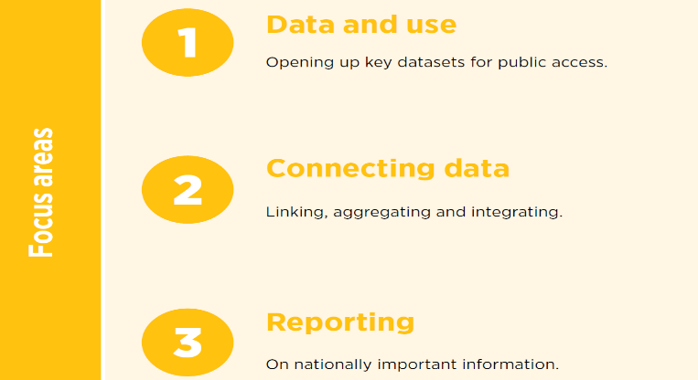
Outcomes Framework

Slide 5
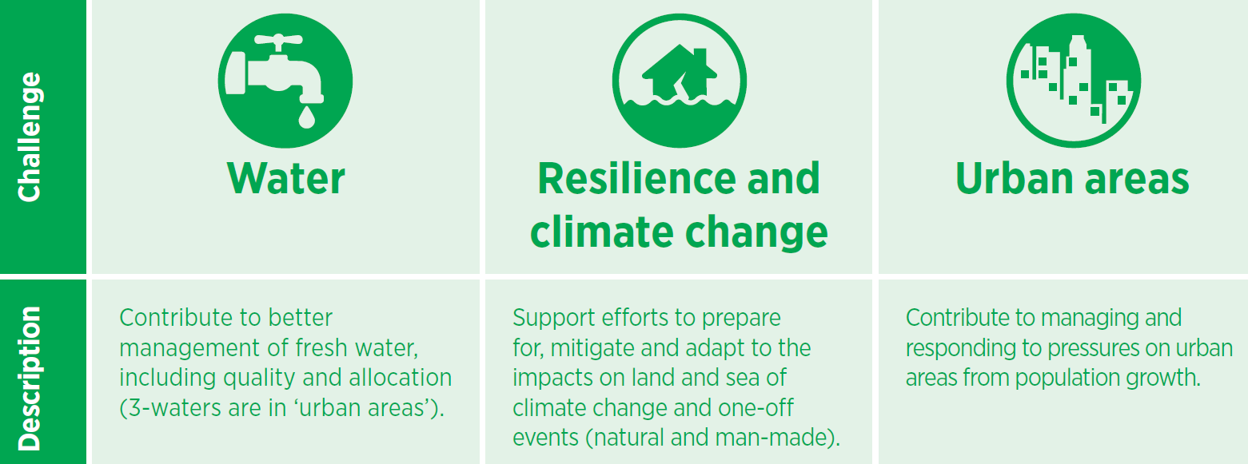
Outcomes Framework

Slide 6
New Zealand Hydrographic Authority
Our contribution to the power of where and high value geographic information
Our Vision
Navigating New Zealand to a thriving blue economy
Our Mission
We collect, manage and share marine geospatial information for the benefit of New Zealand
What is important to us
People can navigate safely
The marine environment is managed sustainably
The value of marine geospatial information is realised
Key datasets are accessible to key users
Our focus areas
Mapping NZ 2025
Coastal mapping
Joining Land and Sea (JLAS)
Improved bathymetry
Resilience
Share data that enables others to:
Assess risk
Understand impacts of climate change
Respond to events
Growing Marine Geospatial Information
Promote our data
Encourage others to release marine data
Enable others to reuse marine geospatial data
How we will work
Meet our maritime obligations
Be digital first, data-centric
Understand our customers
Partner / work collaboratively
Apply fresh thinking and be innovative
Being our BEST

Slide 7
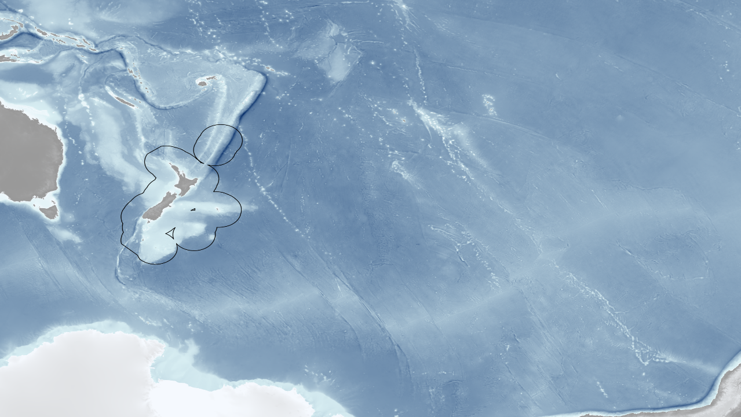
Main achievements during the year
Area of Responsibility
EEZ
New Zealand’s exclusive economic zone is the 5th largest in the world, spanning over 4 million square kilometres and hosting numerous activities important to New Zealand domestically and internationally. Such as:
Fisheries
Tourism
Mineral exploration
Conservation
Scientific discovery

Slide 8
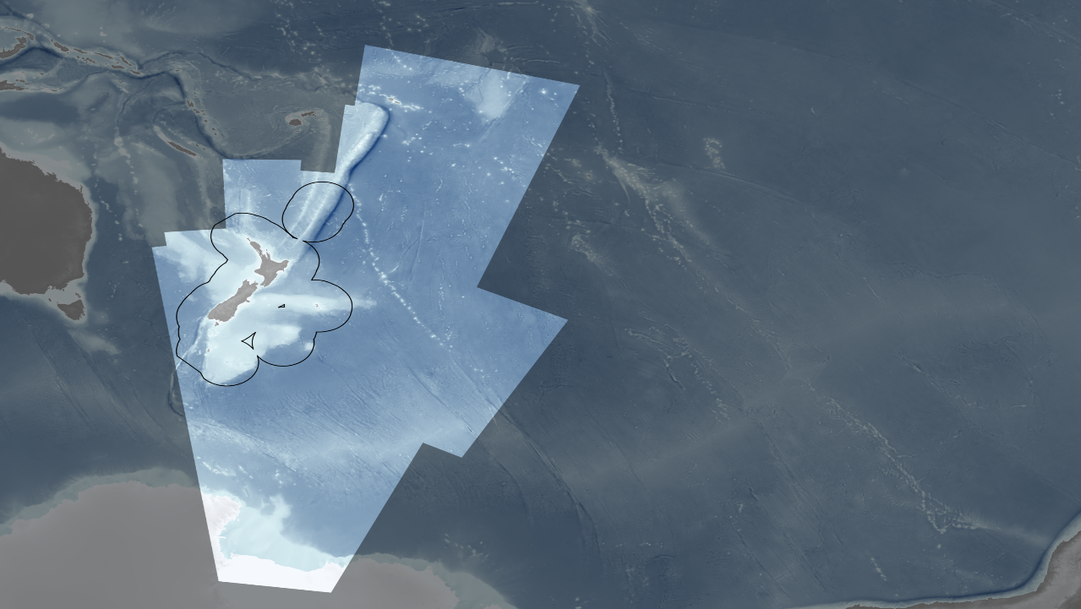
Area of Responsibility
Mapping the Seas
New Zealand is responsible for charting nearly 25 million square kilometres of ocean, from coastal New Zealand, to the Cook Islands, to the South Pacific east of the Chatham Islands, down to the Ross Sea in Antarctica.

Slide 9
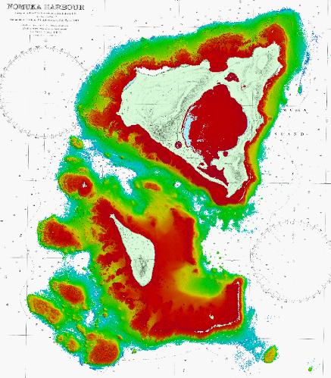
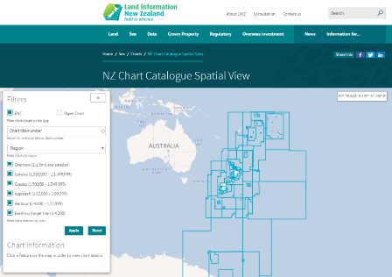
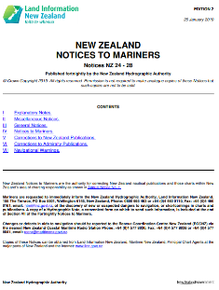
Main achievements during the year
On-line chart catalogue launched
Notices to Mariners publication automated
NZ ENC distribution service trial
hdENC prototype
Full ENC coverage of New Zealand waters
SDB, ALB and MBES data collection
32 ENCs released for PICs
Bilateral signed with Tonga

Slide 10
Main challenges and/or obstructions
Recruiting and retaining qualified and experienced staff
Resourcing to maintain current level of engagement in SWP - competing LINZ priorities

Slide 11
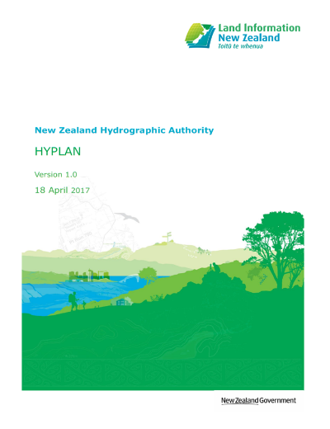
Progress on surveys, charting and MSI
Supply Panel established 2017
3+3 contracts, review late 2019
First survey completed as Panel
6-monthly workshops
Survey Work Requests
Partnerships
Innovation
Capacity building
HYPLAN review
Notes:
Change to procuring survey services
Open RFP intensive process
6 monthly workshops – progress on current projects and what’s next; H&S; Finance; engagement opportunities
New surveys handled by a Survey Work Request under Master Service Agreement
Capacity building – SICs primarily
HYPLAN review – intention to re-run risk assessment; what’s changed. Recently completed risk assessment of Sub-Antarctic Islands, results to be reviewed

Slide 12
Progress on surveys, charting and MSI
Survey Number | Area | Completed
HYD-1718-HS57 | New Zealand, South Island, East Coast – Kaikoura Peninsula to Cape Campbell¹ | Aug 2018
HYD-1718-HS60 | Tonga – Tongatapu, Ha’apai Group, Vava’u Group and Nuias² | Dec 2018
HYD-1718-HS61 | Cook Islands² | Oct 2018
HYD-1718-HS62 | Niue, incl. Beveridge Reef and Antiope Reef² | Oct 2018
HYD-1718-HS63 | Tokelau² | Oct 2018
HYD-1819-HS58 | Fiordland | Underway
HYD-1819-HS59 | Eastern Bay of Plenty | Jan 2018
¹ Partnership with Ministry of Primary Industries to collect bathymetry and backscatter data for scientific purposes.
² Hydrographic surveys comprising SDB, ALB and MBES, funded by NZ Aid programme, Pacific Regional Navigation Initiative (PRNI).

Slide 13
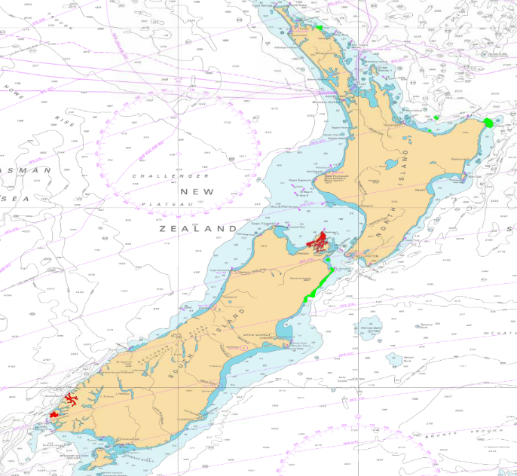
Progress on surveys
Cavalli Passage
Eastern Bay of Plenty
Kaikoura to Cape Campbell
Eastern Bay of Plenty
Cavalli Passage (RNZN)
Fiordland
Western Marlborough Sounds (19/20)
Western Marlborough Sounds
Kaikoura to Cape Campbell
Fiordland

Slide 14
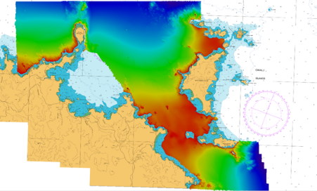
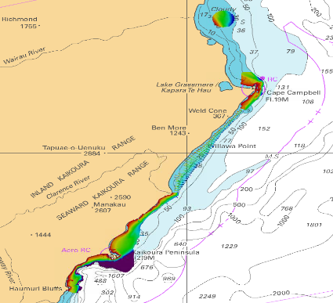
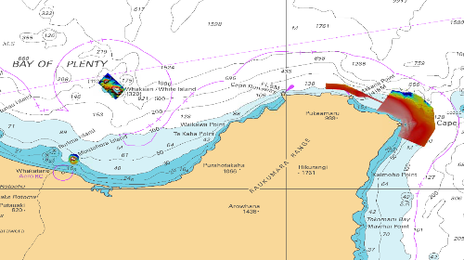
Progress on surveys
Cavalli Passage
Kaikoura to Cape Campbell
Eastern Bay of Plenty

Slide 15
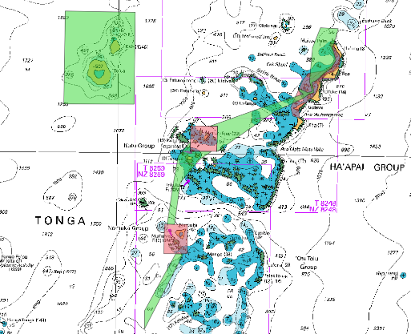
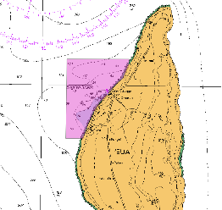
Progress on surveys
Tonga (PRNI)
SDB
2m resolution dataset for the entire Tonga region, providing data to a general depth of 15m, achieving an accuracy equivalent to CATZOC C
ALB
200% coverage of the seafloor to a general water depth of 20m, with a nominal data density of 36 points per 2m²
High resolution imagery
Topographic LiDAR data
MBES
Vessel & USV

Slide 16
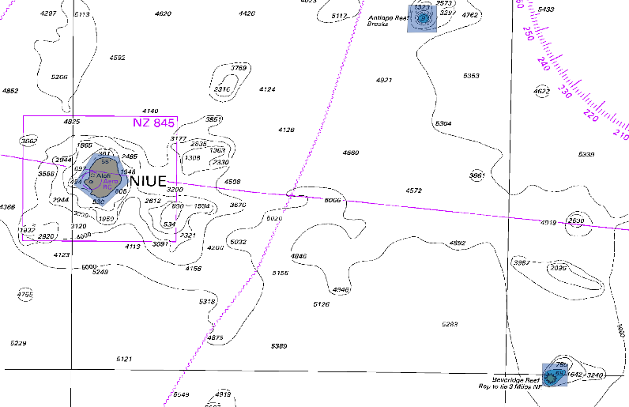
Progress on surveys, charting and MSI
Niue (PRNI)
SDB
Beveridge Reef
Antiope Reef
ALB
Niue
Beveridge Reef

Slide 17
Progress on surveys, charting and MSI
New Zealand ENCs published since the SWPHC15 Meeting
New Zealand Total: 18 New ENC: 3 NE ENC: 15 | South West Pacific Total: 32 New ENC: 0 NE ENC: 32 | Antarctica Total: 0 New ENC: 0 NE ENC: 0 | INT Total: 0 New ENC: 0 NE ENC: 0
New Zealand Paper Charts published since the SWPHC15 Meeting
New Zealand Total: 23 NC: 1 NE: 22 | South West Pacific Total: 9 NC: 0 NE: 9 | Antarctica Total: 0 NC: 0 NE: 0 | INT Total: 0 NC: 0 NE: 0

Slide 18
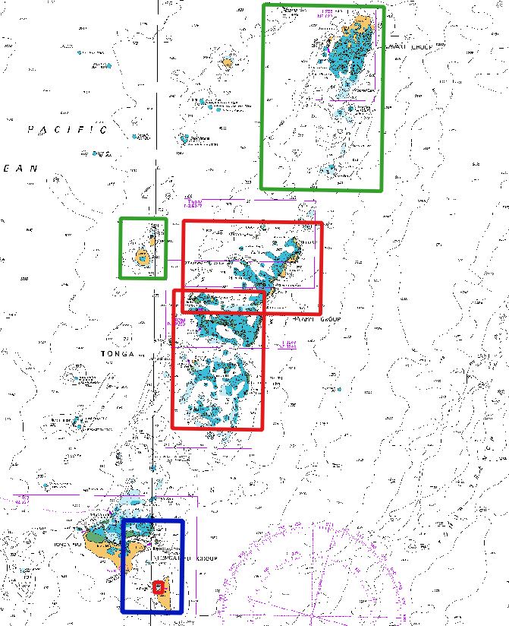
Progress on surveys, charting and MSI
New charts for Tonga and Niue
3 new charts replacing 5 fathoms charts (Tonga)
New chart for Niue, including large scale plan of Beveridge Reef
All incorporating new data from SDB, ALB and MBES

Slide 19
Progress on surveys, charting and MSI
Maritime New Zealand (MNZ) is the NAVAREA XIV Coordinator
Six monthly communications checks with the National Coordinators
National reports received from National Coordinators
Good engagement
LINZ & MNZ hosted IHO CB funded MSI training workshop, Aug 2018
Sunil Kumar (MSAF) joined the training team
CB submission for further MSI training & train-the-trainer

Slide 20
Progress on surveys, charting and MSI
Coastal State/Country | Number of MSI messages | Topics/Subjects of messages | IHO CB Funded MSI Courses Attended
Cook Islands | 2 | Wrecks | 2010, 2014, 2016, 2018
Fiji | 64 | AtoN, Cable laying ops, Pipeline installations, Wrecks | 2010, 2014, 2016, 2018
French Polynesia | 37 | Military exercises, Space debris | 2010, 2014, 2016, 2018
New Caledonia | 28 | Military exercises | 2010, 2014, 2016, 2018
Niue | 1 |  | 2016, 2018
Samoa | 1 | AtoN | 2016, 2018
Tonga | 6 | AtoN, Wrecks, Shoal | 2016, 2018
Tuvalu | 1 | AtoN | 2016, 2018
Wallis & Futuna | Covered by New Caledonia |  | Covered by New Caledonia
Kiribati | 3 | AtoN | 2016, 2018
Notes:
MSI received from National Coordinators
NAVAREA XIV Coordinator reports an increase of MSI over the past 12 months, accredited to engagement and IHO funded training

Slide 21
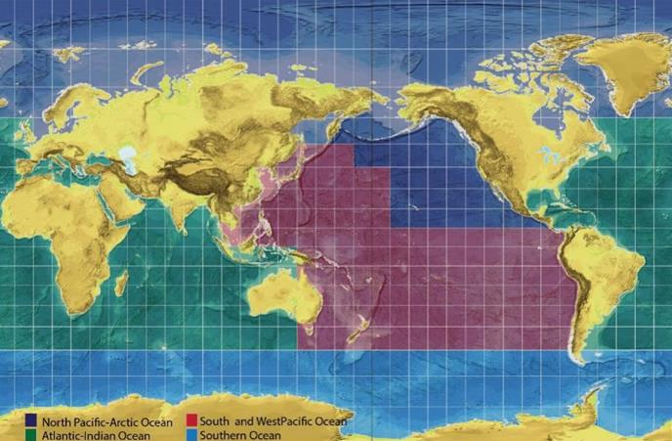
Contributions to the IHO DCDB and GEBCO
GEBCO Seabed 2030
NZ is the Seabed2030 Regional Data Assembly and Coordination Centre (RDACC) for the South and West Pacific Ocean
Operates the South and West Pacific Data Assembly Centre (SaWPac).
Run jointly by NIWA/GNS/LINZ
First batch of data from SaWPac was delivered to the Global GEBCO data centre in November 2018

Slide 22
Progress on MSDI
Forming a National Working Group on Maritime Geospatial Information (MGI)
LINZ is undertaking a national stocktake to identify other marine geospatial datasets
March 2019: IHO MSDIWG, OGC Marine WG and UNGGIM Marine WG
LINZ will respond to the OGC MSDI Concept Development Study request for information
In 2018 LINZ established a coordinator role to access ocean datasets collected by UNCLOS Marine Science Research (MSR) vessels within New Zealand's EEZ.
Notes:
National WG on MGI comprising representatives from government agencies, CRIs, regional councils, universities, and other entities, who have an interest in co-ordinating and improving access to marine geospatial information
In March 2019, LINZ is seeking to attend the following meetings remotely: IHO MSDIWG; OGC Marine WG & UNGGIM Marine WG
The role is to ensure that researchers comply with their obligations to provide voyage and scientific reports, data and samples to New Zealand. LINZ’s MSR Coordinator acts as the point of contact for all MSR-related data and report enquiries.

Slide 23
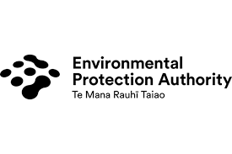
National MGI-WG

Slide 24
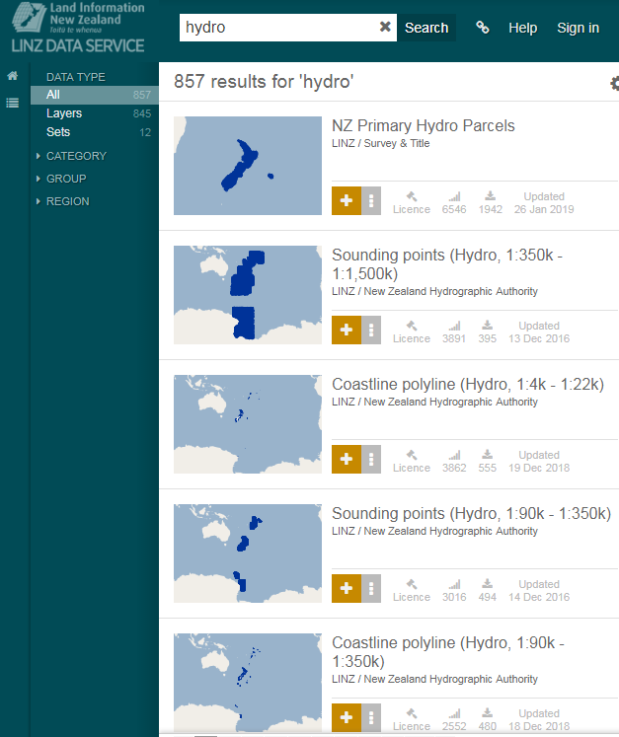
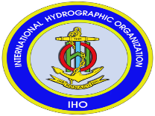
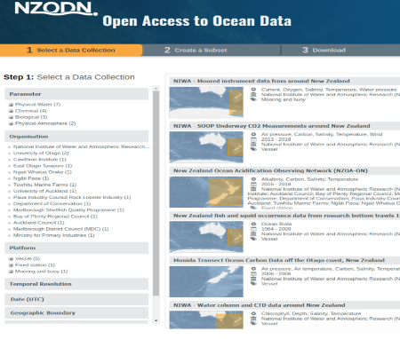
Data re-use

Slide 25
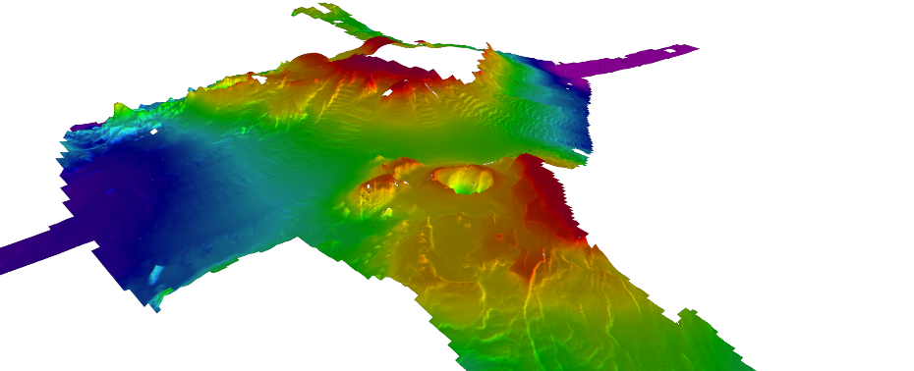
UNCLOS MSR Vessels
Tangaroa Cruise 2007

Slide 26
Progress on MSDI
The former New Zealand Geospatial Office (NZGO) developed a comprehensive work programme for the implementation of a national Spatial Data Infrastructure
NZHA bathymetric data holdings discoverable and available through LINZ Data Service
NZ is a participant in the AusSeabed programme led by Geoscience Australia
Mapping NZ 2025
NZ national survey programme, HYPLAN - partnerships
Notes:
NZHA has extensive bathymetric data holdings and has the responsibility to; ensure the appropriate data management policies and standards are developed to maintain the data; and ensure the data is available and discoverable. In July 2018 an index to bathymetric surfaces was added to LINZ Data Service. Users are now able to identify and request surfaces and scanned sounding sheets through the LINZ Data Service.
NZ is a participant in the AusSeabed program, a national seabed mapping coordination program aiming to serve the Australian community relying on seabed data by coordinating collection efforts in Australian waters and improving data access. The programme is led by Geoscience Australia.

Slide 27
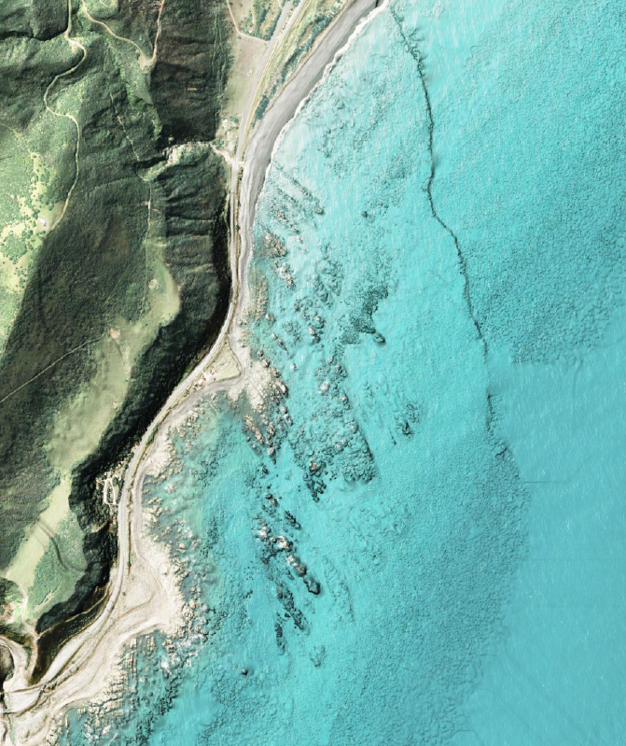
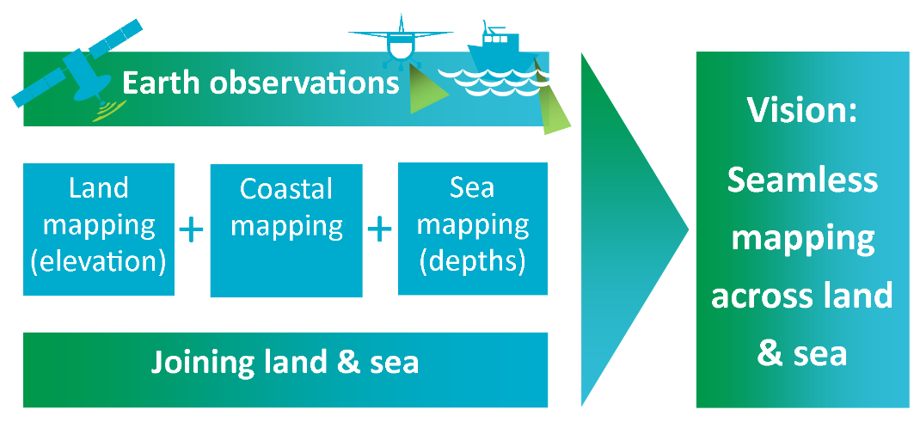
Mapping NZ 2025

Slide 28
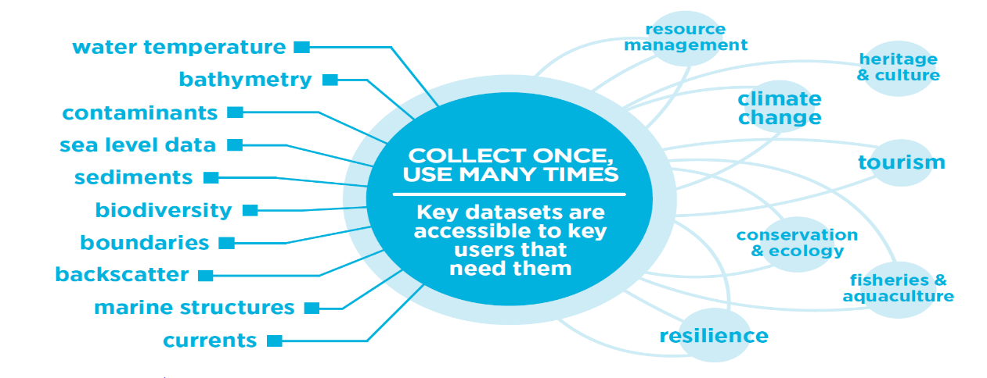
Collect Once Use Many Times

Slide 29
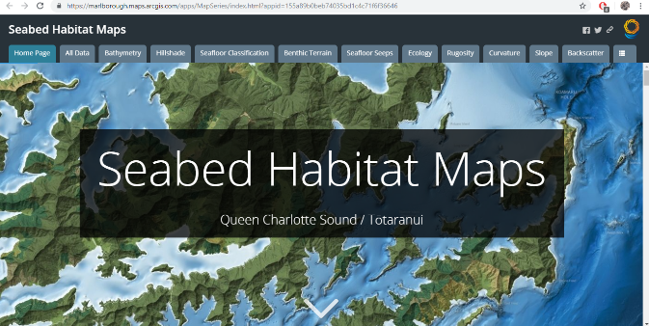
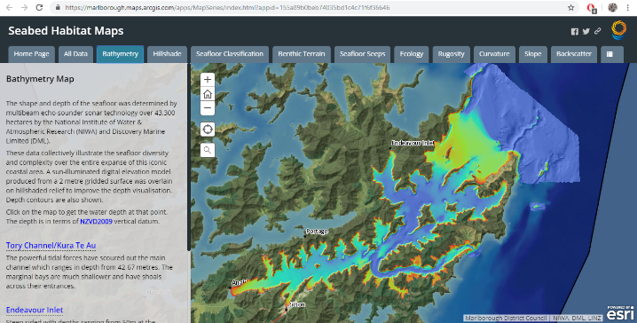
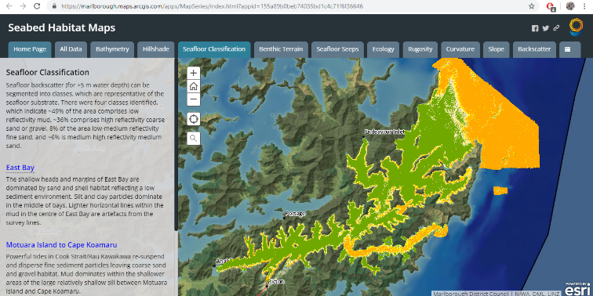
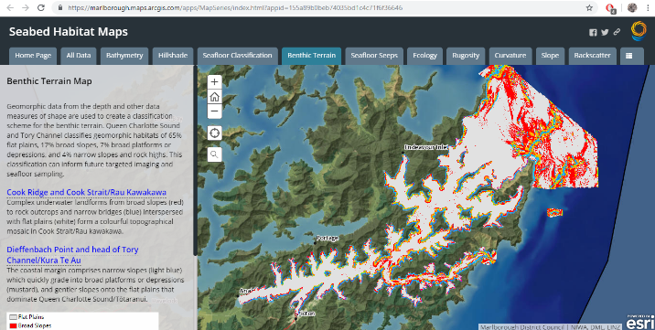
Progress on MSDI
Notes:
MDC Seabed habitat maps
Bathymetry
Seafloor characteristics
Benthic terrain

Slide 30
Plans that affect the region
Pacific Regional Navigation Initiative (PRNI)
Pacific Maritime Safety Programme (PMSP)
The PMSP is a New Zealand Aid-funded programme, administered by the Ministry of Foreign Affairs and Trade (MFAT) and delivered by Maritime NZ.
MFAT established the programme in 2011. The programme has continued to grow and the third phase was approved in 2018.
The countries currently involved are Kiribati, Niue, Tuvalu, Tokelau, Cook Islands, Samoa and Tonga.

Slide 31
Lessons learned to share
Use of risk assessment to identify and prioritise survey & charting programmes is critical
Combined use of SDB, ALB and MBES with review stages
Benefits of Supplier Panel for survey services:
Reduced procurement effort
Change from transactional to partner relationship
Certainty for Suppliers and LINZ

Slide 32
Success stories to share
Cat-A Hydrogaphic Surveyor recruited Sept 2018
Prototype hdENC
NZ ENC Distribution Service
Automated Notice to Mariners publication
Combination of SDB, ALB & MBES – Cook Islands, Niue, Tokelua and Tonga
Involving Tongan Government official with establishing survey control
ALB in Tonga – more than hydrography
Successful use Unmanned Surface Vessel (USV)
Notes:
In Tonga and Niue, the ALB collected around and over islands of use for more than charting
High resolution LiDAR and high definition imagery available to determine land-use and assist with inundation modelling

