Slide 1
The South and West Pacific Centre
123,515,000 km² of ocean
67,000,000 km² outside national jurisdiction
39 countries and territories
~80% deeper than 3000 m
Includes the two deepest ocean trenches: Mariana Trench (10,994 m) Kermadec Trench (10,047 m)

Slide 2
The South and West Pacific Centre Data coverage
Based on Oct 2018 Gap analysis
 | Area (km²) | % of area |  | Available Data (km²) | Available Data (% of area)
0 - 200 m | 4,989,826 | 4% |  | 1,342,377 | 27%
200 - 1500 m | 5,258,836 | 4% |  | 2,156,631 | 41%
1500 - 3000 m | 13,068,933 | 11% |  | 4,600,667 | 35%
3000 - 5750 m | 93,198,225 | 75% |  | 19,692,187 | 21%
5750 - 11000 m | 6,999,943 | 6% |  | 2,919,090 | 42%
Total | 123,515,763 |  |  | 30,710,952 | 25%
SaWPaC mainly deep water ->

Slide 3
Seabed 2030 Phases
X + Y + Z = 100%
Data
NOT in Grid
Map
the
Gaps
GEBCO_2014

Slide 5
How to complete the GEBCO Grid?
Illustration: Marine Dep. Malaysia
Coordinate and inspire mapping expeditions/surveys
Global ocean mapping community
Vast amounts of data collected but yet NOT available for the GEBCO Grid (Y)
Build on SCRUM as GEBCO regional mapping model
Build on TSCOM for technical advances
Technology innovation
Human capacity development
Facilitate crowd sourced data
New mapping technologies

Slide 6
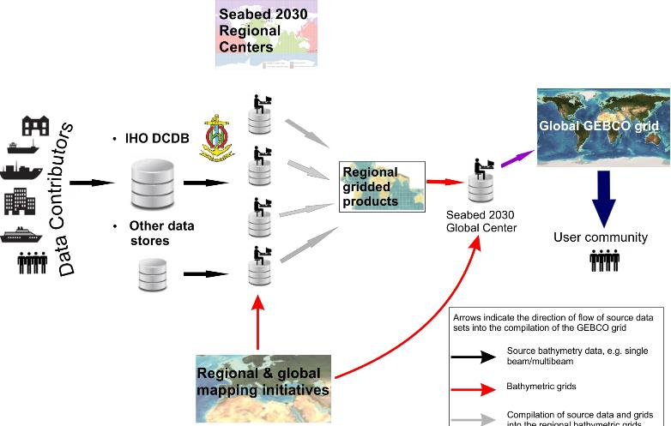
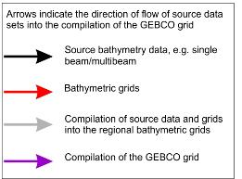
Seabed 2030 Preferred Data Flow
n

Slide 7
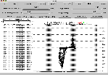
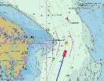
Other supported data flows
Data Sources
Raw & Processed
Swath Files
Options to submitting data directly to Regional or Global Centers:
Public data access (preferred)
Data forwarded to IHO-DCDB for archive and public access
Restricted data access
Data forwarded to IHO-DCDB for archive and restricted access
Private data access
Data not forwarded to IHO-DCDB, archived at Seabed 2030 Center
Usage restricted to only inclusion in GEBCO Products;
no distribution of data
ENC xyz
Single-beam
Gridded data

Slide 8
How you can get involved
Contribute data
Acquire data to fill gaps in coverage
Regional Mapping Committees
GEBCO Meetings
Spread the word!
https://seabed2030.gebco.net
@seabed2030

Slide 9
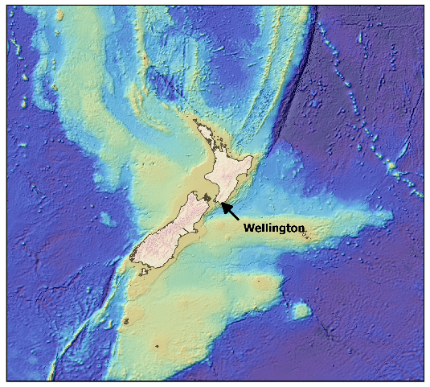
South and West Pacific Regional Center Mapping Committee Inaugural Workshop
Inaugural Seabed 2030 South and West Pacific Meeting
4-6 March 2019 - Wellington, New Zealand
All welcome!
Establish Regional Mapping Committee
Identify sources of bathymetric data
Methods for data sharing and management
Identify upcoming voyages
Register on seabed2030.gebco.net/pacific/
Contact me on pacific@seabed2030.org

Slide 10
Call to Action
Support data availability at Seabed 2030 target resolution
Facilitate legal availability at Seabed 2030 target resolution
Engage with Regional Centers or Global Center
Support & promote GEBCO activities & products

Slide 11
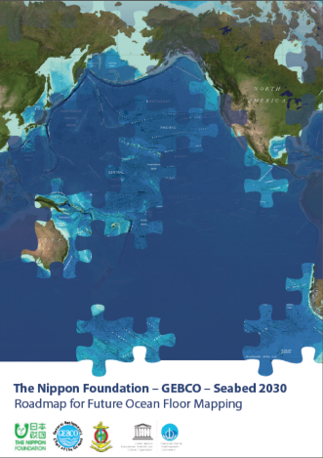
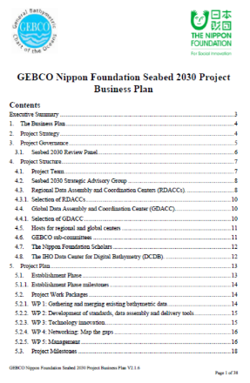
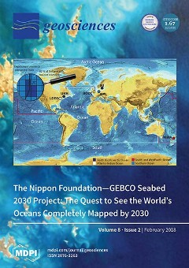
Key Documents
10 year Business Plan
Technical paper
https://seabed2030.gebco.net/
doi:10.3390/geosciences8020063
Roadmap
https://seabed2030.gebco.net/

Slide 12
Thank you!
pacific@seabed2030.org
Centre Head:
Geoffroy Lamarche
+64 21 1895 732
geoffroy.lamarche@niwa.co.nz

Slide 13
Break down of the source of data types that the GEBCO grid is based on
Grid cell type (30 arc-second) | GEBCO_2014 | New grid
Interpolation guided by satellite-derived gravity data | 66.5% | 62.4%
Interpolation guided by computer programme, e.g. GMT | 14% | 14.3%
Multibeam | 9% | 12.4%
Single beam | 1.9% | 1.8%
Pre-generated grid | 2.7% | 4.3%
Unidentified track type | 3.9% | 2.8%
Isolated soundings, e.g. ENC soundings | 0.1% | 0.1%
Contours | 1.9% | 1.9%

