Slide 1
16th South West Pacific Hydrographic Commission Technical Workshop 11th-12th February Alofi – Niue
IMSAS and the role of the SWPHC
Francesca Pradelli – Acting Regional Safety Navigation Adviser
SPC – Ocean and Maritime Programme

Slide 2
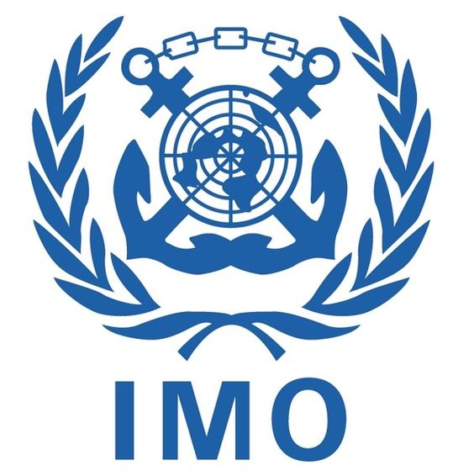
Background
The International Maritime Organization (IMO) Member State Audit Scheme (IMSAS) has become mandatory on 1 January 2016
IMSAS background
IMSAS scope
IMSAS schedule in the Pacific
Tuvalu, Tonga, Solomon Islands, Palau, Marshall Islands
to be audited in 2019/2020
Notes:
5 countries left: Tuvalu, March 2019; Tonga, June 2019; Solomon Islands, July 2019; Palau, November 2019; Marshall Islands, September 2020.

Slide 3
Framework & Procedures (Resolution A.1067(28)
7. Scope
IMO Instruments - the applicable IMO instruments related to the areas listed below;
(i) safety of life at sea,
(ii) prevention of pollution from ships,
(iii) standards of training, certfication and
watchkeeping for seafarers ,
(iv) loadlines,
(v) tonnage measurement of ships, and
(vi) regulations for preventing collisions at sea.

Slide 4
Framework & Procedures (Resolution A.1067(28)
7. Scope
Obligations & Responsibilities - those contained in the applicable IMO instruments provided such instruments have entered into force for the Member State, in its capacity as a flag, port and coastal state.
Areas to be covered by the audit -Member State’s implementation and enforcement of applicable IMO instruments in its legislation, the effectiveness of its control and monitoring mechanism, etc…………………..

Slide 5
III Code (Resolution A.1070(28)
Part 1 – Common Areas
4 : Scope (para 6)
safety of life at sea;
prevention of pollution from ships;
standards of training, certification and watchkeeping for seafarers;
load lines;
tonnage measurement of ships; and
regulations for preventing collisions at sea.

Slide 6
III Code (Resolution A.1070(28)
Part 3 – Coastal State
1: Implementation
Rights, obligations and responsibilities may include, inter alia:
radiocommunication services
meteorological services
search and rescue services
hydrographic services
ships' routeing
ship reporting systems
vessel traffic services
aids to navigation

Slide 7
Hydrography in IMSAS
IMSAS
Safety of life at sea
Pollution prevention
Standards trainings
Load line
Tonnage
COLREGS
SAFETY OF LIFE AT SEA
SOLAS Chap. V
SOLAS CHAP. V
Reg. 9: Hydrography

Slide 8
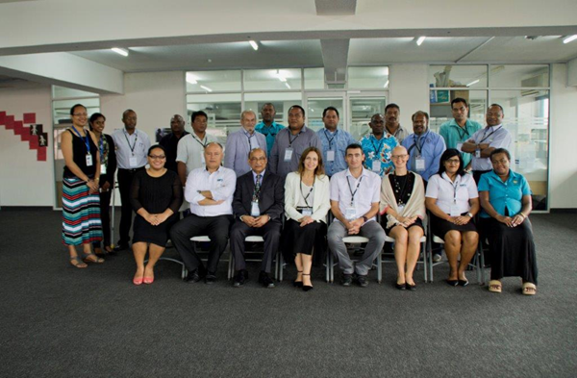
SPC Regional Assistance in preparation for IMSAS
first Regional Workshop on the Implementation of IMSAS – Suva (Fiji), 21 to 25 September 2015
attended by representatives from Cook Islands, Fiji, Kiribati, Papua New Guinea, Samoa, Solomon Islands, Tuvalu and Vanuatu
main objective
outcome: roadmap to facilitate PICs effective preparation for IMSAS (19 steps)

Slide 9
National Assistance
IMSAS Awareness workshop
1. 2015/2016/2017 countries: Tuvalu, Vanuatu, Kiribati, Solomon Islands, Samoa
2. outcome: national roadmaps towards IMSAS
Strategy to implement international instruments
Upon official request, SPC assisted Vanuatu, Kiribati, Solomon Islands and Samoa in developing their own national Strategy
Maritime Transport Policy
Upon official request SPC assisted Vanuatu, Kiribati, Palau in developping
their own national MTP
Legal gap analysis in the scope of IMSAS
4 Spreadsheets developed taking into account IMO Resolution A.1105(29) 2015
Non-Exhaustive list of obligations under instruments relevant to the IMO Instruments Implementation Code
Upon official request SPC conducted legal gap analysis in Vanuatu, Tuvalu, Kiribati,
Samoa

Slide 10
What IMO says
“ The assistance provided by SPC to the countries in the region in preparation for their audits under IMSAS is greatly appreciated from our side and it made a difference in actual audits conducted”.
Head, Member State Audits
Department for Member State Audit and Implementation Support
International Maritime Organization (IMO)

Slide 11
From 2017, SPC assistance focused on Maritime Training, Safety of Life at Sea, Ports operations, Energy Efficiency in shipping
Regional Strategy on Safety of Navigation in the Pacific

Slide 13
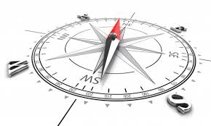
Purpose
support Pacific Islands Countries and Territories (PICTs) and guide development partners through an integrated and coordinated approach to improve the safety of navigation in the Pacific
provide a regional a platform to coordinate, monitoring, communication and reporting on all safety of navigation related initiatives to PICTs and development partners
establish and sustain regional coordination mechanisms and strategic partnerships to achieve economies of scale and promote complementary actions amongst development partners active in the sector

Slide 14
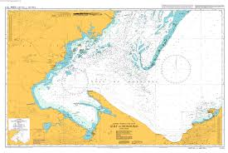
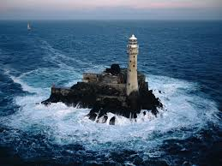
Implementation
areas of safety of navigation
i) Safety of Navigation governance
ii) Navigation and meteorological services and warnings
iii) Hydrographic services
iv) Aids to Navigation and vessels traffic services
v) Search and Rescue services
Coordination function at the regional level which includes aggregating information and capturing progress through monitoring is attributed to the Pacific Community (SPC)

Slide 15
Transport Ministers’ agreement
During the Third Pacific Regional Energy and Transport Ministers’ Meeting (Tonga, April 2017), country representatives:
Endorsed the Regional Strategy on Safety of Navigation in the Pacific;
Agreed for PICTs to actively engage in the implementation, monitoring and evaluation of all safety of navigation related projects and programmes within the framework of the Regional Strategy; and
Supported the adoption a consistent national approach on membership of international and regional organisations and to ratification of or accession to international and regional instruments in relevant areas of safety of navigation.

Slide 16
Performance Monitoring Plan
Overall objective and results | Performance measure | Means of verification (MOV) | Schedule for collection | Responsibility
Goal To ensure that navigation in the waters under the jurisdiction of PICTs is safe for any person or vessel at sea, that the environment is protected, and that international and domestic vessel traffic is facilitated to support the sustainable development of PICTs
Specific objective To support PICTs to improve the provision of their safety of navigation services (SoN) in accordance with their international obligations | Number of PICTs providing adequate SoN services in accordance with international requirements, guidelines and recommendations
Result 1 PICTs provide effective services that fulfil their SoN obligations | Evidence of PICTs with functional and well maintained SoN infrastructure Evidence of PICTs with effective SoN services being provided Evidence of effective capacity building through SoN related initiatives | PICT SoN audit/review reports Project training reports | Annually | IMO/IHO/IALA/SPC/SPREP Project implementers
Result 2 PICT SoN projects and initiatives are designed in line with the Strategy addressing its five components | Number of regional and/or country projects and initiatives addressing the five components of the Strategy | SoN project design documents SoN project evaluation documents | Annually | Development partners, regional agencies and PICTs
Result 3 Coordination among PICTs and development partners for the implementation of SoN projects and initiatives is improved | Evidence of information sharing and coordinated projects being planned to address country needs in line with the Strategy Number of regional coordination meetings held | Strategy review/evaluation report | Two years | SPC
Result 4 Greater visibility and awareness of PICT status in achieving their SoN obligations | Number of updated reports on PICT performance and progress against the five components as noted in the Strategy | Annual state of SoN in the Pacific reports produced by the partnership desk | Annually | SPC

Slide 17
Fakaaue lahi

