Slide 1
International Association of Marine Aids to Navigation and Lighthouse Authorities
IALA and the World-Wide Academy

Slide 2
contents
IALA
IALA World-Wide Academy
IALA in the future
Notes:
Omar Frits Eriksson was hoping to attend this meeting, but he had to send his appologies.
Omar has recently taken over the post as Deputy Secretary General of IALA, and he had to attend an IALA event this week in Paris France in his capacity as the Deputy.
Omar continues to be the Dean of the World-Wide Academy, and hopes to be able to attend the next Hydrographic Commission meeting.

Slide 3
Headquarters
St. Germain-en-Laye, near Paris, is the home base of IALA providing:
Offices of the permanent secretariat and
IT-equipped meeting rooms for technical committees, workshops and seminars

Slide 4
Membership
Notes:
Number of members is increasing steadily and is presently over 300 members.

Slide 5
The IALA ‘motto’ and principal aims
"Successful voyages, sustainable planet"
To harmonise standards for Aids to Navigation systems worldwide
To facilitate the safe and efficient movement of shipping
To enhance the protection of the marine environment

Slide 6
IALA Strategic Goals for 2026
Goal 1
Marine Aids to Navigation are developed and harmonized through international cooperation and the provision of standards.
Goal 2
All coastal states have contributed to a sustainable and efficient global network of Marine Aids to Navigation through capacity building and the sharing of expertise.
Notes:
IALA has two strategic goals

Slide 7
The Maritime Buoyage Agreement
IALA A and IALA B
During the IALA conference in November 1980 two navigation marking systems, i.e. the System A (red color at left hand side of the ship) and the System B (red color at right hand side of the ship), were combined into one - the IALA Maritime Buoyage System.
Notes:
IALA´s major achievement is the Maritime buoyage system, which has lead to the harmonization of aids to navigation world-wide.
IALA continues to maintain this system, and encourages all coastal states to use it.

Slide 8
The Committees
The “Power House” of IALA
AtoN Requirements and Management (ARM)
Engineering and Sustainability (ENG)
Vessel Traffic Services (VTS)
e-Navigation (ENAV)
Notes:
IALA has four technical committees which meet twice every year.
These are the workhorses of IALA, and they produce all IALA documentation.

Slide 9
Publications
Main result of the Committees’ work
Standards which can be referred to directly in IMO and other international conventions and in national maritime laws.
Recommendations which advise what should be done.
Guidelines which advise how to implement the recommendations as ‘best practice’.
Manuals which provide general reference materials (NAVGUIDE; MBS; VTS Guide; IALA Dictionary).
Model courses which provide guidance on the training of VTS personnel, Aids to Navigation Managers and Aids to Navigation Technicians.
Notes:
These are the types of documents produced and published by IALA.

Slide 10
The World-Wide Academy
Training and capacity building

Slide 11
There are some challenges out there…
Source: MarineTraffic.com
Notes:
The volume of traffic and degree of risk is considerable worldwide. Also in the pacific there are areas with considerable traffic and resulting risk.

Slide 12
IALA Strategic 2014-2026 Goals for “Successful voyages, sustainable planet.”
G1 – Marine Aids to Navigation are harmonised through international cooperation and the provision of standards.
G2 ‐ All coastal states have contributed to an efficient global network of Marine Aids to Navigation through capacity building and the sharing of expertise.
Notes:
The world-wide Academy focuses on the second strategic goal, to get all coastal states to contribute towards a globally harmonized system of aids to navigation.

Slide 13
The IALA World-Wide Academy
Inaugurated January 2012
Independently funded
Integral part of IALA
1. Education and training
2. Capacity building, and
3. Research & development
Notes:
Inaugurated in 2012
Working in these three areas (more on next slide)

Slide 14
What do we do?
Education and Training
Oversee IALA Training Accreditation scheme
Support Accredited Training Organisations
Deliver training on Risk Management and other special topics
Capacity Building
High Level Missions, raising awareness
Technical Assessment Missions to Coastal States in need
Long-term partnership and follow up activities with Coastal States
Research & Development
Determine knowledge gaps and need for R&D
Promote R&D
Harvest R&D results and feed this into IALA Committees
Meanwhile, we have a lot of fun.
Notes:
This is what the Academy does.

Slide 15
World-Wide Academy Capacity Building in developing countries
Notes:
Capacity building is one of the more important areas, since it, over time, brings developing states iton conformance with their international obligations and hopefully ensures that they will follow the iALA Mamritime Buoyage System.

Slide 16
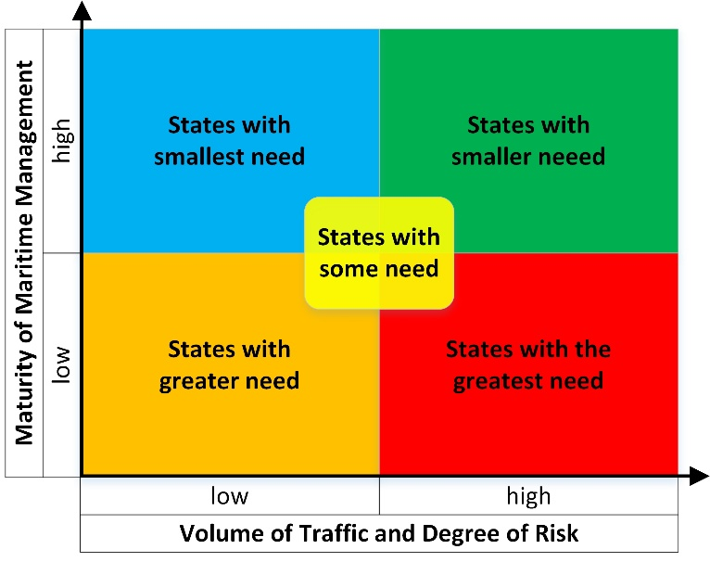
Maritime Management Quality
Notes:
The Academy has classified all coastal states of the world into categories depending on their need for capacity building.

Slide 17
States in need (2018)
Priority 1-3 Reduced from 78 to 62 since 2012
Notes:
There are 26 states in the red (priority 1) zone. None of them are in the pacific.
In the pacific there are three in priority 2 and one in priority 3.

Slide 18
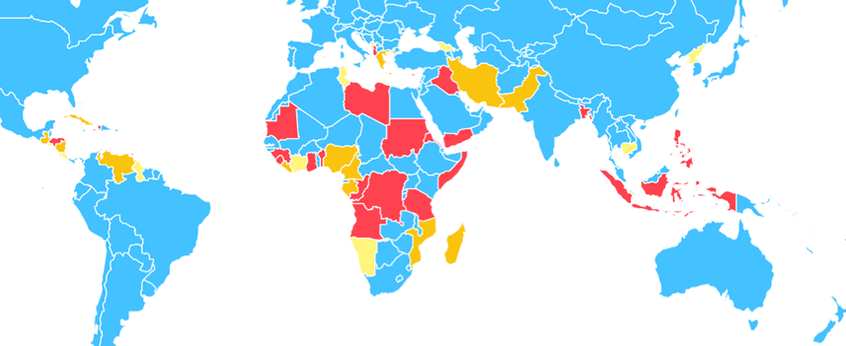
Those in need (still) The Pacific is doing well
Priority
1
2
3
Notes:
The highest concentration of states in need is in Africa.

Slide 19
Education and Training

Slide 20
Current Level 1 AtoN Manager Training Scheme
Notes:
IALA has developed what we call Level 1 Aids to Navigation Manager course.
It is a four week residential course (lover bit), but it is possible to take the first three weeks as distance learning.

Slide 21
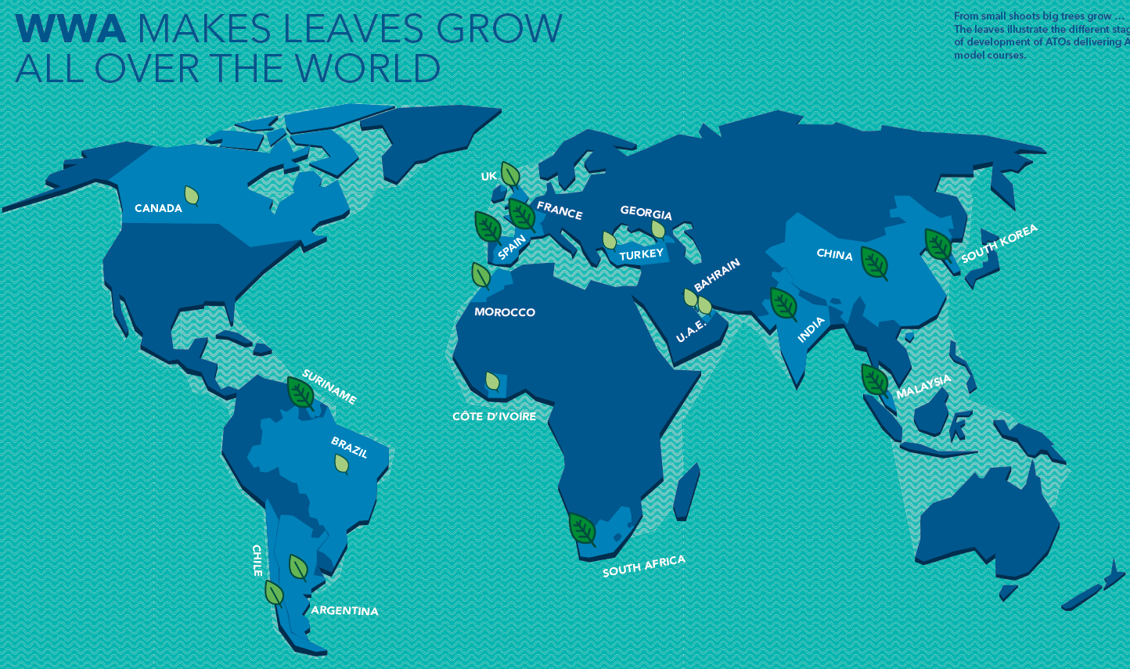
Notes:
The big leaves are accredited training organizations delivering the Level 1 course, the smaller leaves are training organizations who are planning to do so.
We hope that someday there will be an Accredited training organization in Fiji.

Slide 22
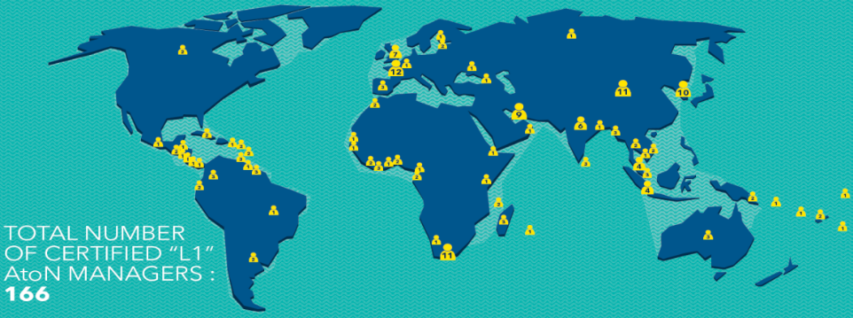
International Level 1 Aids to Navigation Managers
200+
Notes:
The results of Level 1 training is more than 200 internationally certified Level 1 Aids to Navigation Managers, many of whom are from the Pacific.
IALA encourages all coastal states to employ one or two certified aids to navigation managers.
Some sponsorship may be available.

Slide 23
The IALA World-Wide Academy Team Jacques, Gerardine, Omar and Kevin
Notes:
This is the Academy crew.
We have replaced Stephen with a younger model called Kevin Gregory.

Slide 24
Transforming IALA from Non-Governmental status to Inter-Governmental status
Notes:
The most important development within IALA these days is the transformation of IALA from an NGO to an IGO.

Slide 25
Advantages of IGO Status
Increased international acceptance of Standards and existing Recommendations and Guidelines due to direct participation by Governments. Harmonization will be enhanced.
Enhanced liaison with IMO and IHO – with IALA as an equal partner. Synergies between this trinity of excellence will make more efficient use of the resources available.
Headquarters agreement with host nation will provide additional financial, operational and human resource capabilities and reduce bureaucratic hurdles. foMembers.
Notes:
There are several advantages with becoming an IGO

Slide 26
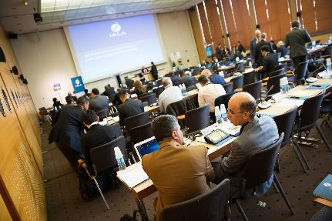
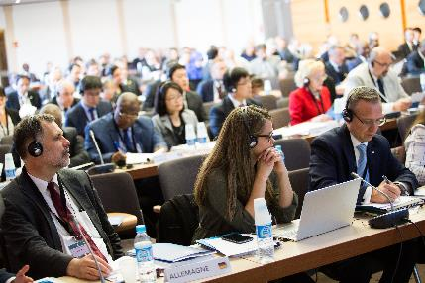
Diplomatic Conference – France and Morocco
Notes:
IALA has conducted two preparatory diplomatic conferences, one i Paris and one in Morocco where diplomats from all over the world met and discussed the text of the new IALA Convention, which will be the basis of the Intergovernmental IALA.

Slide 27
Roadmap
18-19 April 2017: First Preparatory Diplomatic Conference, Paris.
May - September 2017: The Secretariat received written comments on the draft Convention and the draft General Regulations.
October 2017: The Secretariat collated all received written comments and made them available on the dedicated web site.
30-31 October 2017: The IALA Legal Advisory Panel, open to all National Members, developed amended draft texts for the IALA Convention/General Regulations, as appropriate.
7-8 February 2018: Second Preparatory Diplomatic Conference, Marrakech to consider the revised texts.
12-14 March 2019: Third Preparatory Diplomatic Conference, Istanbul to consider the revised texts.
Notes:
The third and hopefully final preparatory Diplomatic conference will be held in Istanbul, Turkey 12-14 March this year.
All coastal states are invited, and IALA would like to urge all of you to send a representative to this conference. IALA really needs your support in this matter.
Once 30 coastal states have signed the new convention, IALA will change its status to an IGO.
In conclusion, IALA and the World-Wide Academy wish you a succesful meeting and we hope to meet again soon.

Slide 28
Connect:
E-mail: omar.eriksson@iala-aism.org
LinkedIn: Omar Frits Eriksson
Twitter: OMaritime
Mobile: +33 6 31 17 76 42

