Slide 1
16th Meeting of the South West Pacific Hydrographic Commission Technical Workshop on Disaster Response Planning and Data Discovery
IHO CB Strategy and importance of MSI
Basic steps for implementing MSI

Slide 2
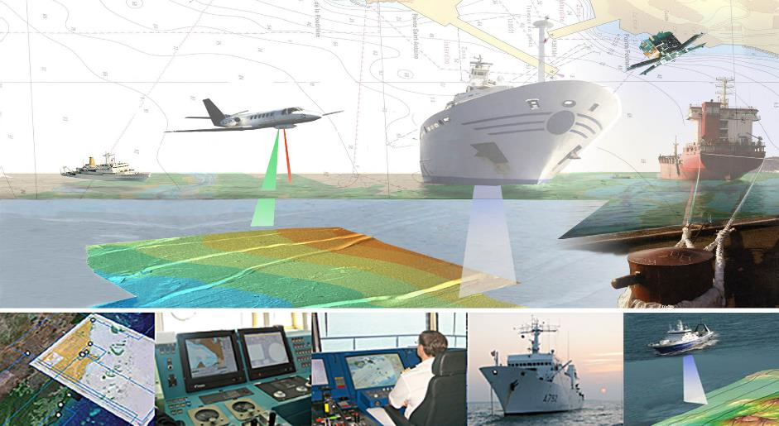
IHO CB Strategy
www.iho.int/cb → CB Strategy

Slide 3
Summary
Introduction
IHO CB Strategy
Strategic aspect of MSI
What is MSI
Basic steps to implement MSI
Conclusion

Slide 4
Introduction
Capacity Building (CB) - Concept
CB is defined as the process by which the IHO assesses and assists in sustainable development and improvement of the States, to meet the objectives of the IHO and the obligations and recommendations related to hydrography, charting and maritime safety as described in SOLAS Chapter V, UNCLOS and other international instruments.

Slide 5
Introduction
Capacity Building
Capacity Building is a strategic objective of the IHO.

Slide 6
Introduction
Capacity Building Sub-Committee (CBSC)
The CBSC was established to coordinate the CB efforts, under the IRCC.
The CBSC is the guardian of the IHO CB Strategy.

Slide 7
Summary
Introduction
IHO CB Strategy
Strategic aspect of MSI
What is MSI
Basic steps to implement MSI
Conclusion

Slide 8
IHO CB Strategy
Capacity building is a vital component of the efforts of intergovernmental technical organizations to support the sustainable development goals of the UN. The IHO is committed to matching its efforts to those of the IMO, the IOC, the IALA, the FIG, SPC and other organizations working in allied fields.

Slide 9
IHO CB Strategy
Principles:
national needs should be assessed firmly against the 3 CB phases
capacity building projects should be coordinated regionally and through regional cooperation
the national administration of a State with developing hydrographic services must embrace and support the concept of CB as being in its national interest

Slide 10
IHO CB Strategy
Principles:
funding of Non-MS is generally limited to technical visits and Phase 1 projects, awareness and technical assistance

Slide 11
IHO CB Strategy
Phases of development of hydrographic surveying and nautical charting capability:
Phase 1: MSI
Phase 2: surveying
Phase 3: nautical charting

Slide 12
IHO CB Strategy
Phase 1: MSI
Phases of Development | National Activity
Phase 1 Collection and circulation of nautical information, necessary to maintain existing charts and publications up to date | Form National Authority (NA) and/or National Hydrographic Coordinating Committee (NHCC). Create/improve current infrastructure to collect and circulate information Strengthen links with charting authority to enable updating of charts and publications Minimal training needed Strengthen links with NAVAREA Coordinator to enable the promulgation of safety information

Slide 13
IHO CB Strategy
Phase 2: surveying
Phases of Development | National Activity
Phase 2 Creation of a surveying capability to conduct: Coastal projects Offshore projects | Establish capacity to enable surveys of ports and their approaches Maintain adequate aids to navigation Build capacity to enable surveys in support of coastal and offshore areas Build capacity to set up hydrographic databases to support the work of the NA/NHCC Provide basic geospatial data via MSDI Requires funding for training, advising & equipment or contract survey

Slide 14
IHO CB Strategy
Phase 3: nautical charting
Phases of Development | National Activity
Phase 3 Produce paper charts, ENC and publications independently | The need shall be thoroughly assessed. Requires investment for production, distribution and updating Alternatively, bi-lateral agreements for charting can provide easier solutions in production and distribution (of ENC through RENCs) and rewards. Further development of MSDI

Slide 15
IHO CB Strategy
Long term objectives:
• to enable all states with navigable waters to achieve Phase 1 and to develop a national plan to put in place appropriate elements of Phases 2 and 3 or alternative cooperative regional or bilateral arrangements.

Slide 16
IHO CB Strategy
Long term objectives:
• in conjunction with the IMO’s Technical Cooperation Committee and IALA’s World Wide Academy a series of ‘country profiles’ will be developed to accurately measure the state of hydrography in every coastal State.

Slide 17
IHO CB Strategy
The CB Process (the 4 As):
Degree of engagement (X = Low, XX = Medium-low, XXX = Medium-high, XXXX = High)
 | IHO | CBSC | RHC | Country
Awareness | XXX | XXXX | XX | X
Assessment | X | XXX | XXXX | XX
Analysis | XXXX | XXX | XX | X
Action | X | XX | XXX | XXXX

Slide 18
IHO CB Strategy
Assessment of needs is done by:
high-level visits
technical visits
risk analysis

Slide 19
IHO CB Strategy
CB annual cycle:
Assessment (RHC)
Planning (RHC)
Submission for support (RHC)
Preparation of the CB Plan (Secretariat)
Adoption of the CBWP (CBSC)
Implementation and impact assessment (RHC, Secretariat, CBSC, IRCC, Council)

Slide 20
Summary
Introduction
IHO CB Strategy
Strategic aspect of MSI
What is MSI
Basic steps to implement MSI
Conclusion

Slide 21
Strategic aspects of MSI
Why is MSI so important?
Maritime Safety Information is the fundamental piece of information that needs to be made available to the mariner to ensure safety of navigation!
Through the WWNWS the mariner will receive the elements to urgent updates to nautical charts and other warnings.

Slide 22
Strategic aspects of MSI
Why is MSI so important?
Without MSI, hydrographic services (SOLAS V/9) can’t be provided

Slide 23
Summary
Introduction
IHO CB Strategy
Strategic aspect of MSI
What is MSI
Basic steps to implement MSI
Conclusion

Slide 24
What is MSI
Reference:
IHO Publication S-53 Joint IMO/IHO/WMO Manual on Maritime Safety Information (January 2016)

Slide 25
What is MSI
Maritime Safety Information (MSI) means navigational and meteorological warnings, meteorological forecasts and other urgent safety-related messages broadcast to ships.

Slide 26
What is MSI
Maritime safety information service means the internationally and nationally coordinated network of broadcasts containing information which is necessary for safe navigation.

Slide 27
What is MSI
Maritime safety information is grouped in:
Local warnings (ports)
Coastal warnings (national coordinator)
Sub-area warnings (Sub-area coordinator)
NAVAREA warnings (NAVAREA coordinator)

Slide 28
What is MSI
Maritime safety information is promulgated by the Global Maritime Distress and Safety System (GMDSS), the global communications service based upon automated systems, both satellite and terrestrial, to provide distress alerting and promulgation of maritime safety information for mariners.

Slide 29
What is MSI
SafetyNET
GMDSS
NAVTEX

Slide 30
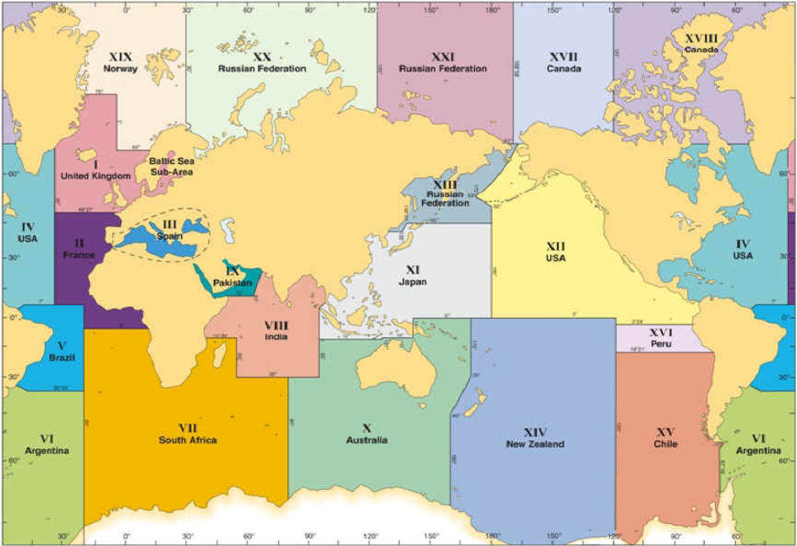
NAVAREAS

Slide 31
Summary
Introduction
IHO CB Strategy
Strategic aspect of MSI
What is MSI
Basic steps to implement MSI
Conclusion

Slide 32
Basic steps to implement MSI
What do I need to put MSI in place?
A national coordinator
An email account
A telephone line
Access to the relevant information
The will to do it!

Slide 33
Basic steps to implement MSI
Designate a National Coordinator
Train the National Coordinator
Establish a communication plan to access relevant information
Collect the relevant information
Draft the MSI messages
Send MSI messages to the NAVAREA Coordinator

Slide 34
Basic steps to implement MSI
Examples of MSI message (1):
NAVAREA XIII 145/14
SEA OF OKHOTSK.
WESTERN PART.
CHART ________ (INT _______ ).
ISOLATED DANGER BUOY 54-49.9N 142-04.1E MISSING

Slide 35
Basic steps to implement MSI
Examples of MSI message (2):
NAVAREA X 346/14
AUSTRALIA NORTH EAST COAST.
ARCHER POINT.
CHART ________ (INT _______ ).
LIGHT 15-35.6S 145-19.7E UNRELIABLE.

Slide 36
Basic steps to implement MSI
Examples of MSI message (3):
NAVAREA VII 345/14
MOZAMBIQUE CHANNEL.
PORT OF MAPUTO.
CHART ________ (INT _______ ).
BAIXO RIBEIRO LIGHT 25-54.6S 032-48.1E UNLIT

Slide 37
Basic steps to implement MSI
Examples of MSI message (4):
NAVAREA III 45/14
TUNISIA, EAST COAST.
RADE DE SFAX.
CHART ________ (INT _______ ).
WRECK REPORTED IN VICINITY 34-41.5N 010-54.0E.

Slide 38
Basic steps to implement MSI
Examples of MSI message (6):
NAVAREA IV 210/14
JAMAICA, SOUTHWARDS.
PEDRO BANK.
CHART 26050
SOUTHWEST ROCK LIGHT, FL (3) 10 SECONDS 7 METRES 5M ESTABLISHED 16-47.55N 078-11.48W.

Slide 39
Basic steps to implement MSI
Examples of MSI message (7):
NAVAREA VII 58/14
SOUTH ATLANTIC OCEAN.
CHART ________ (INT _______ ).
TUG RIG DELIVERER WILL TOW VESSEL AGATE ISLAND FROM RECIFE, BRAZIL TO CAPE TOWN, COMMENCING 09 JUN 14, ETA CAPE TOWN 09 JUL 14. LENGTH OF TOW 550 METRES WIDE BERTH REQUESTED.

Slide 40
Basic steps to implement MSI
Examples of MSI message (8):
NAVAREA II 78/14
PAZENN.
CHART ________ (INT _______ ).
1. SIX CONTAINERS ADRIFT IN VICINITY
47-37N 006-26W AT 262200 UTC JUL 14.
2. CANCEL THIS MSG 292200 UTC JUL 14

Slide 41
Basic steps to implement MSI
Examples of MSI message (9):
NAVAREA I 112/14
CELTIC SEA.
CELTIC DEEP.
CHART ________ (INT _______ ).
1. DERELICT FISHING VESSEL REPORTED ADRIFT 51-25.5N 006-21.9W AT 132210 UTC NOV 14.
2. CANCEL THIS MSG 162210 UTC NOV 14.

Slide 42
Basic steps to implement MSI
Examples of MSI message (10):
NAVAREA XIV 67/14
NEW ZEALAND.
COOK STRAIT.
CHART ________ (INT _______ ).
SAR OPERATION IN PROGRESS CENTRED ON 40-24.5S 173-57.6E. ALL VESSELS NOT UNDER INSTRUCTION OF THE SAR MISSION CONTROLLER RCCNZ ARE REQUESTED TO KEEP A WIDE BERTH.

Slide 43
Basic steps to implement MSI
Examples of MSI message (11):
NAVAREA I 25/14
ENGLAND SOUTH COAST.
LYME BAY, BEER HEAD WESTWARDS.
CHART ________ (INT _______ ).
ANTIPOLLUTION OPERATIONS IN PROGRESS 50-40.0N 003-10.0W. A TEMPORARY EXCLUSION ZONE RADIUS TWO MILES HAS BEEN ESTABLISHED CENTRED ON THIS POSITION. SHIPS ARE PROHIBITED FROM ENTERING OR REMAINING WITHIN THIS ZONE.

Slide 44
Basic steps to implement MSI
Examples of MSI message (12):
NAVAREA XII 222/14
COSTA RICA.
SOUTHWEST COAST.
CHART ________ (INT _______ ).
SHOALS LOCATED:
A. 28 METRES 08-17.1N 083-53.1W.
B. 13.5 METRES 08-19.2N 083-54.2W.
C. 27 METRES 08-21.8N 083-56.1W.

Slide 45
Basic steps to implement MSI
Examples of MSI message (13):
NAVAREA IV 231/14
NORTH PACIFIC OCEAN.
JASPER SEAMOUNT.
CHART ________ (INT _______ ).
DISCOLOURED WATER WITH SUBMARINE VOLCANIC ACTIVITY REPORTED VICINITY 30-27N 122-40W AT 190110 UTC FEB 14

Slide 46
Basic steps to implement MSI
Examples of MSI message (14):
NAVAREA VII 256/14
ATLANTIC OCEAN.
ANGOLA.
CHART ________ (INT _______ ).
M/V GECO EMERALD IS CONDUCTING SEISMIC SURVEY OPERATIONS AND TOWING SIX STREAMERS AT 8000 METRE LENGTH WITH ENDS MARKED WITH YELLOW BUOYS AND BLUE FLASHING LIGHTS IN AREA BOUNDED …

Slide 47
Basic steps to implement MSI
Examples of MSI message (15):
NAVAREA XIII 55/14
TATARSKIY PROLIV.
PROLIV LAPERUZA.
CHART ________ (INT _______ ).
1. CABLE LAYING OPERATIONS IN PROGRESS BY SHIP SUBARU UNTIL 30 JUN 14 ALONG LINE JOINING 45–56.8N 140–00.7E, 46–36.5N 140–53.6E, 46-36.6N 141–29.0E, 46–38.9N 141–47.3E, 46–36.5N 141-49.8E. WIDE BERTH REQUESTED.

Slide 48
Basic steps to implement MSI
Examples of MSI message (16):
NAVAREA VII 321/14
MADAGASCAR.
PORT OF MAJUNGA.
CHART ________ (INT _______ ).
TWO TIDE GAUGES AND A CURRENT METER MOORED IN AREA BOUNDED BY: 15-32.70S, 15-33.03S, 046-11.77E AND 046-11.53E.

Slide 49
Basic steps to implement MSI
Examples of MSI message (17):
NAVAREA XI 95/14
HOKKAIDO, EAST COAST AND OKHOTSK COAST.
TSUNAMI WARNING.
TSUNAMI WARNING AT 130436 UTC JAN 14. DANGEROUS DRIFTING OBJECTS, CHANGE OF DEPTH AND DAMAGE OF HARBOUR FACILITIES OR NAVIGATIONAL AIDS MAY OCCUR.

Slide 50
Basic steps to implement MSI
Examples of MSI message (18):
SUBAREA I 233/14
SOUTHERN BALTIC, THE BELTS, THE SOUND.
THE WATER LEVEL IS EXPECTED TO DROP 80 CM BELOW MSL AFTERNOON 20 AUG 14, RISING TO ABOUT MSL MORNING 21 AUG 14.

Slide 51
Summary
Introduction
IHO CB Strategy
Strategic aspect of MSI
What is MSI
Basic steps to implement MSI
Conclusion

Slide 52
Conclusion
It is much more inexpensive to send MSI than to remediate the damages caused by the lack of proper information and outdated charts.

Slide 53
IHO Secretariat, here to help you! www.iho.int abri.kampfer@iho.int alberto.neves@iho.int

