Slide 1
South West Pacific Hydrographic Commission Technical Workshop February 2019 Alofi, Niue
Working with your Primary Charting Authority
CDRE Fiona Freeman

Slide 2
PCAs for the SWPHC
Primary Charting Authority (PCA) | Responsible for:
Australia | Papua New Guinea, Solomon Islands
France | French Polynesia, New Caledonia, Wallis and Futuna
New Zealand | Cook Islands, Niue, Samoa, Tonga, Tokelau
United Kingdom | Fiji, Kiribati, Pitcairn Island, Tuvalu, Vanuatu, Nauru
United States | American Samoa, Federated States of Micronesia, Marianas Islands, Marshall Islands, Palau

Slide 3
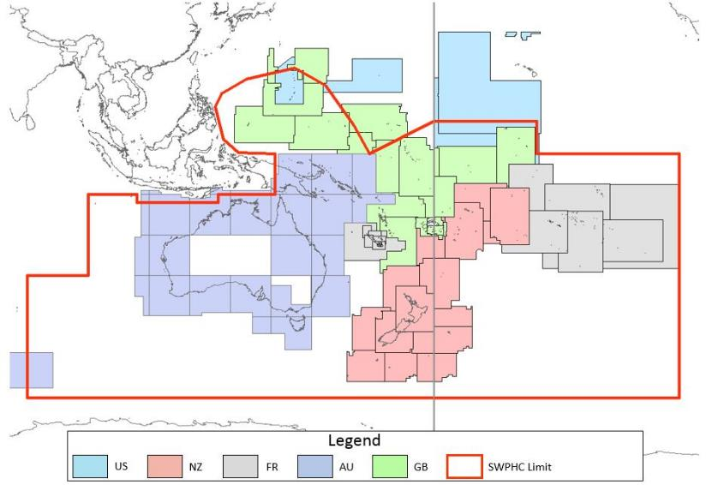
PCAs for the SWPHC

Slide 4
What is a PCA?
The term Primary Charting Authority, or PCA, is not defined.
It essentially describes the role that an established hydrographic office, or charting authority, can fulfil for another nation.
The range of functions provided by the PCA are normally agreed bilaterally and therefore vary based on the need of the other nation.

Slide 5
Framework for the PCA
SOLAS Chapter V Regulation 2:
"Nautical chart" or "nautical publication" is a special-purpose map or book, or a specially compiled database from which such a map or book is derived, that is issued officially by or on the authority of a Government, authorized Hydrographic Office or other relevant government institution and is designed to meet the requirements of marine navigation.

Slide 6
Framework for the PCA
IHO Publication S4
B-611.7 – Notice to Mariners (NM) originated by authorities concerning waters which are not their national charting responsibility should not normally be acted upon without obtaining corroboration from the national charting authority, if there is one. In certain circumstances, another hydrographic office may act as the ‘primary’ charting authority, for example where:
• there is no national hydrographic office; or
• where the responsible national agency, which does not itself produce charts, has agreed.
In such cases, NM issued by the primary charting hydrographic office in those waters may be regarded as authoritative.
Notes:
N

Slide 7
Framework for the PCA – INT Charts
IHO Publication S11
Article 3.11.1 - In most cases, the allocation of Producer Nations for INT charts will be a fairly straightforward process. For most medium- and large-scale INT charts, the Producer Nation will be the IHO Member State with responsibility for charting the waters covered by these charts. There will, however, be some exceptions. (For further information, see S-4 A-203).
IHO Publication S4
A-203 PRODUCERS A-203.1 Producers of medium- and large-scale international charts will normally be the hydrographic offices with a national responsibility for the waters concerned.
Notes:
N

Slide 8
What does/can a PCA do for you?
Assist in meeting SOLAS obligations for hydrographic services
Provide charting services
Provide hydrographic surveying services
Provide technical assistance and advice
Advocate for support

Slide 9
PCA and Disaster Response
Establish communications with your PCA as soon as possible.
Provide information to PCA on status of waterways and infrastructure to enable Maritime Safety Updates to be promulgated.
Provide information on prioritising of surveying and charting requirements.

Slide 10
Conclusion – So What?
A PCA can assist a nation in meeting obligations, but does not absolve the nation of those obligations.
Determine what is needed and establish formal arrangements through a bilateral to establish accountability framework – review as necessary.
Use your PCA and engage them actively – maintain communication.

