Slide 1
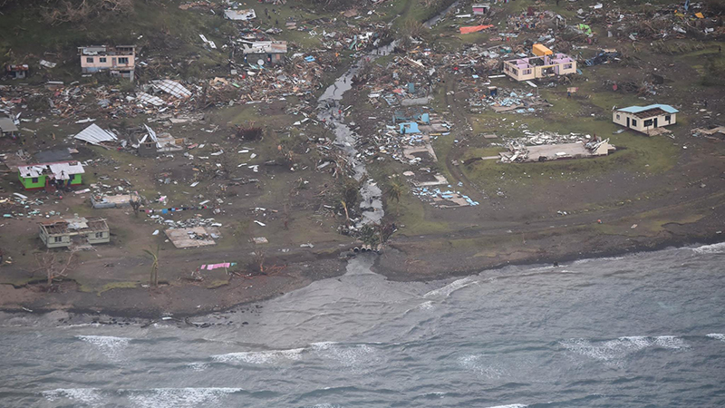
LESSON LEARNT TC WINSTON – 20 Feb 2016

Slide 2
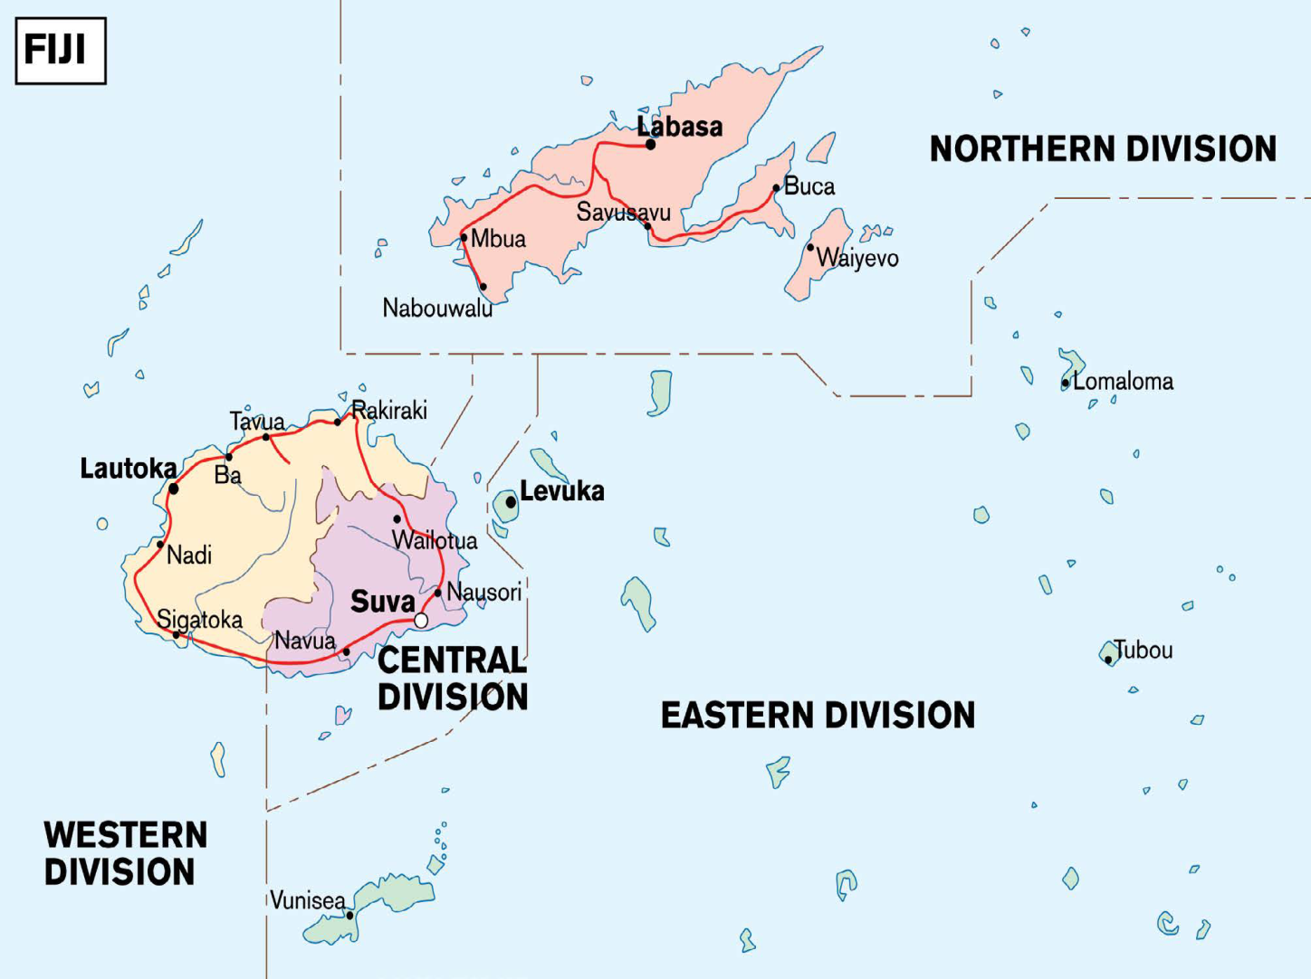
To Highlight some of the experience of TC Winston
AIM

Slide 3
SCOPE
Introduction
Sequence of Events
Planning Arrangement
Joint Efforts (Vessel Used)
Hydrographic Challenges
Way Forward
Q & A

Slide 4
Introduction

Slide 5
285 km/hr winds
44 Lives were claimed
About 350, 000 people were directly Affected
$US1.4 billion of Damage

Slide 6
Sequence of Events
11 Feb 16 – TC Winston formed as Category 1
20 Feb 16 - TC Winston Hitting Vanuabalavu as Cat 5 -Declaration State of Emergency(60 days)
21 Feb 16 – Aerial Assessment by RNZAF P3 Orion
22 Feb 16 – Send Recovery Team to Koro Island
26 Feb 16 – TC Winston moving away from Fiji

Slide 7
Planning Arrangement
Disaster Management Council
National Controller
National Coordinator
Future Ops
Current Ops
EOC
EOC Central
EOC Eastern
EOC Western
EOC Northern

Slide 8
Vessels
Fiji – 03 PB – 04 GSS – 02 RORO – 01 FV
ADF – 01
NZDF -02
HMTDF – 02
French - 01

Slide 9
Hydrographic Challenges
Did not have SMB and Survey vessel
Neglected to be used for Post Disaster Survey
Ships cannot deliver cargoes and services
Delay on supply of recovery equipment
Conflict of interest from the high level

Slide 10
Way Forward
SOP for Post Disaster survey
Procurement of Drones and UAV
More dialogue with other stakeholders

Slide 11
VINAKA VAKALEVU QUESTIONS!!!!!!!!!!

