Slide 1
DISASTER RESPONSE PLANNING IN SAMOA
Prepared by Makerita Atonio
Ministry of Works, Transport & Infrastructure

Slide 2
Outline
Policy and Legal Framework
Disaster Response Operational Procedure (DROP)
Organisational Framework for Response
The Response Procedure
Tropical Cyclone & Tsunami impacts

Slide 3
Policy & Legal Framework
Disaster and Emergency Management Act 2007
National Disaster Management Plan (section 9 of Act)
Sector Plans
Ministry/Agency Response and Contingency Plan

Slide 4
1. Disaster Response Operational Procedure
1.1 Purpose
focuses on disaster response coordination, outlines operational procedures and response structure
Minimise duplication of efforts and resources
Clear understanding of roles and responsibilities
Ensures timely implementation of disaster response
Organisational Framework for Response
Response Operational Procedures

Slide 5
1. Disaster Response Operational Procedure
1.2 Scope
DROP must be used in the event of a declared disaster (Prime Minister orders a declaration of disaster on the advice of DAC)
It can also used to facilitate a coordinated response to emergencies or hazards which do not require a formal declaration

Slide 6
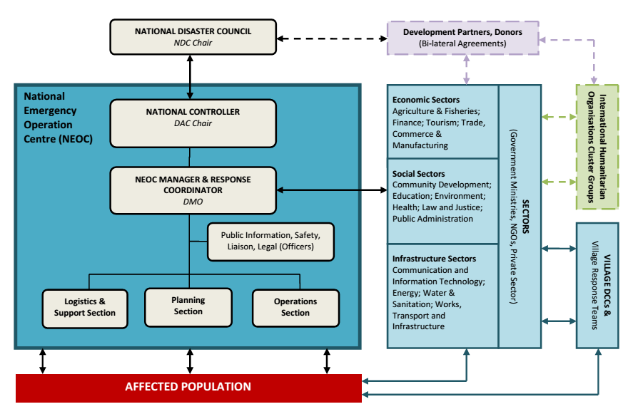
2. Organisational Framework for Response
National Disaster Response Structure

Slide 7
2. Organisational Framework for Response
2.1 Roles in Disaster Response Structure
2.1.1 National Disaster Council (NDC)
Setting strategic direction
Conflict resolution
2.1.2 NEOC - National Controller (DAC Chair)
Reports directly to NDC Chairperson
Management and oversight of all incident activities
Approve ordering and release of resources

Slide 8
2. Organisational Framework for Response
2.1.3 Sectors
- First responders to any disaster situation will conduct rapid assessment to provide an initial overview of impact and report to the NEOC.
2.1.4 Village Disaster and Climate Committee
DCC and trained village response teams as first responders within the village community
2.1.5 Response Agencies (key lead and support agency)
2.1.6 International and Regional Humanitarian Partners

Slide 9
3. The Response Process
3.1 NEOC Activation Stages
Stage 1 – Standby
Stage 2 – Action
Stage 3 – Stand-down
(This escalation process will avoid over-response and serves as guide for response agency)
3.2 Response Actions
- Rapid assessment should be conducted within the first 72 hours of receiving information on disaster
- Identify problems, their sources and consequences
- Initial damage assessment, continuous and updated information to determine exact disaster situation.

Slide 10
3. The Response Process
3.3 International Assistance for Response or Recovery
Direct participation in response operations e.g. use of specialised aircraft
Provision of urgent relief supplies e.g food, medical, tents for temporary shelter
3.3.1 Process to request international assistance
Requests can only be submitted to aid agencies and donors on direction of the Council
After realising the situation at hand is beyond the capabilities of the existing national resources
3.4 Debriefs and Reporting
3.4.1 Debriefs – conducted asap after the event
3.4.2 Implementation of debrief recommendations

Slide 11
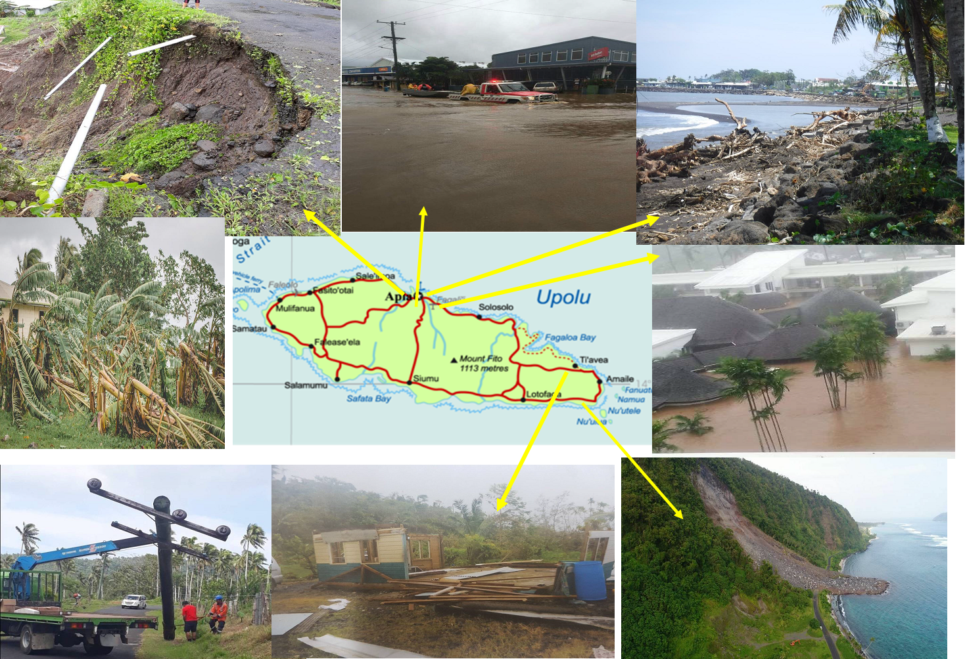
Category 2: TC Gita

Slide 12
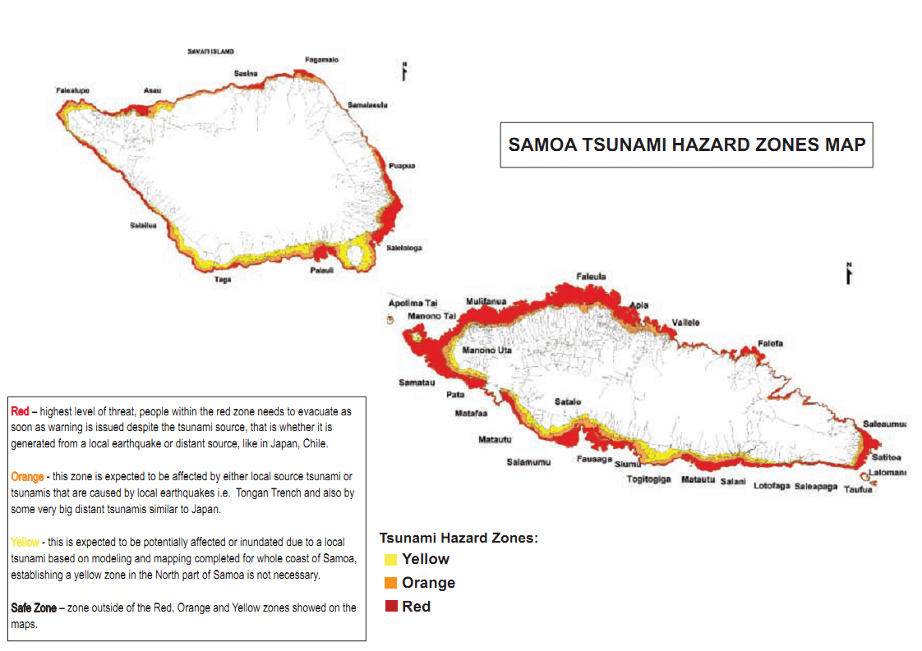
SAMOA TSUNAMI HAZARD ZONES MAP

Slide 13
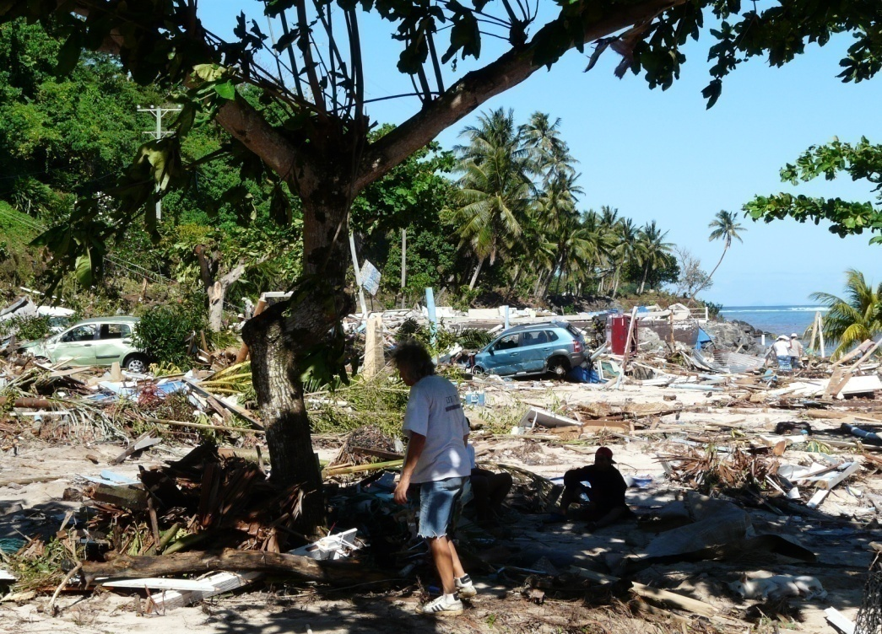
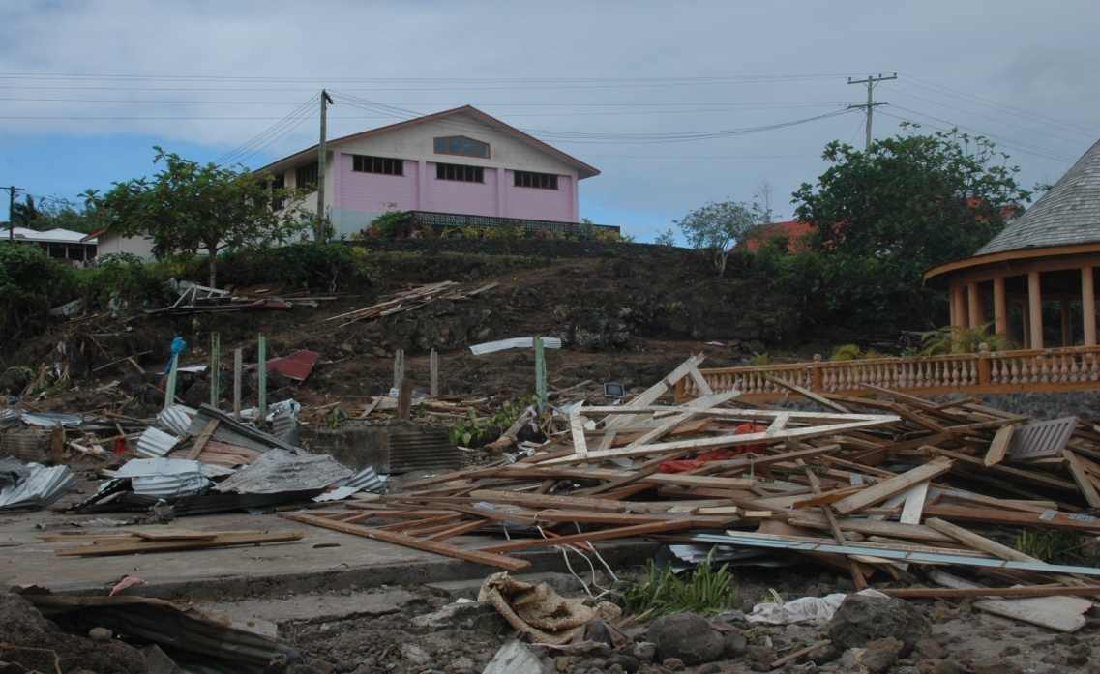
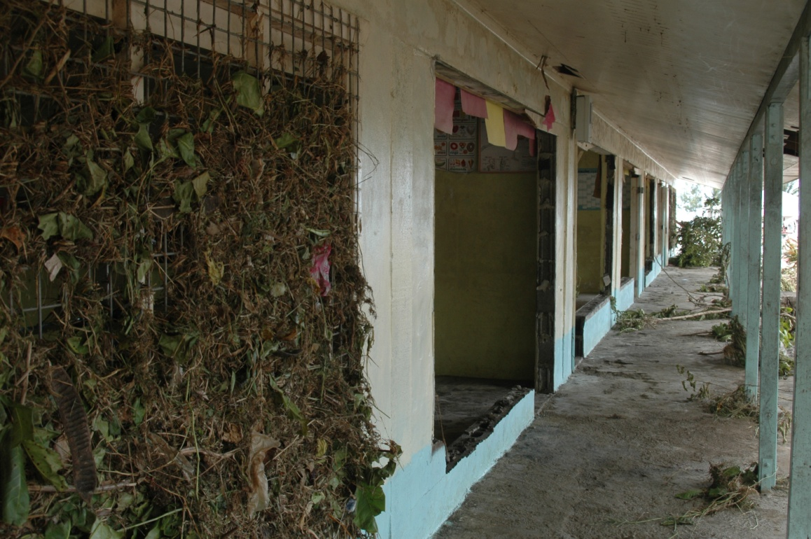
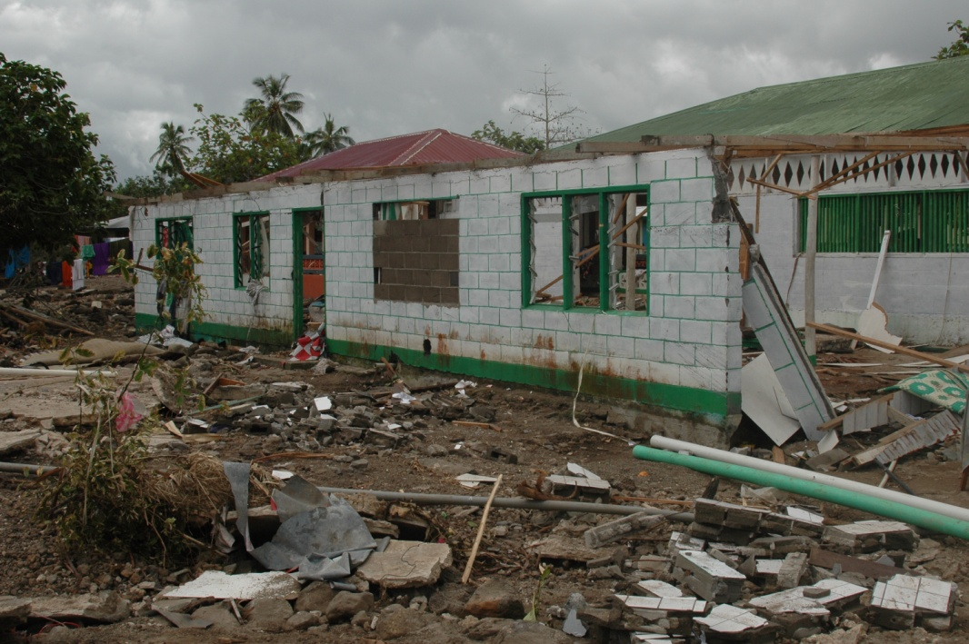
Tsunami in 2009: South East of Upolu

Slide 14
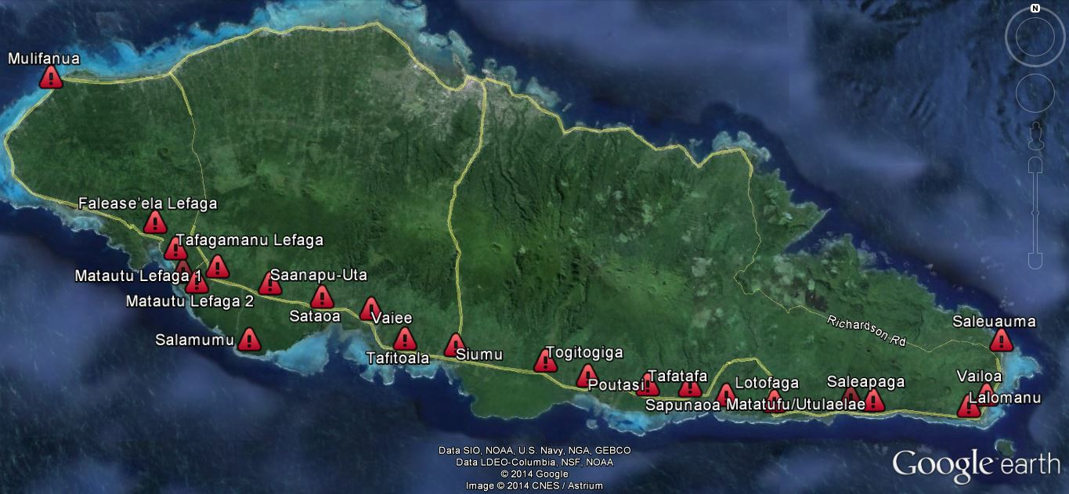
EMERGENCY SIREN NETWORK
Test Tone
Warning
Stand Down
23 sirens
Test first Monday of Every Month at 3pm
Can be activated from NEOC or manually in the villages.

Slide 15
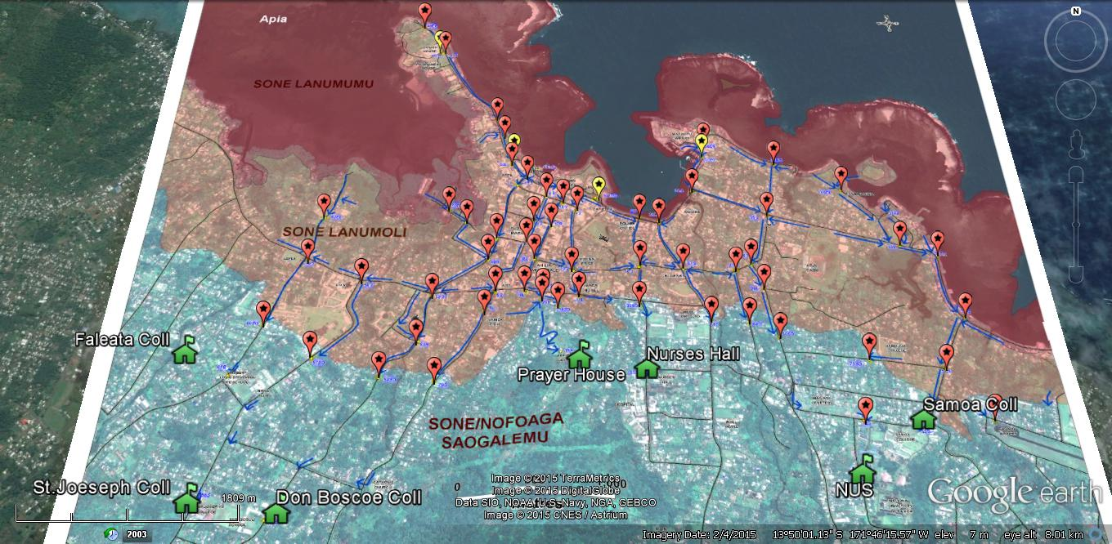
Tsunami Evacuation Route-Apia

Slide 16
Official Source of Information & Warnings for Samoa
The Meteorology Office under the MNRE is the main & ONLY Official source of information on weather forecasts & natural hazard warnings for Samoa with information being shared on the following;
MNRE official website: www.mnre.gov.ws or the MET office official web pg: samet.gov.ws
Facebook pg: @samoameterologicalservices
However, DMO/NEOC is the main official source of information during Disaster Preparation & Response.

Slide 17
How we get the message out?
SMS Text Messages
ERN & ESN Networks
Active Facebook and Twitter channels
https://www.facebook.com/DMOSamoa
https://www.twitter.com/DMO_Samoa
Email: dmosamoa@gmail.com
Ministry Website: www.mnre.gov
Radio Channels: AM 540 or any FM station
TV Stations- TV1, EFKS TV, TV 3
Church Bells and other Traditional methods

Slide 18
EMERGENCY SERVICES
Samoa Fire & Emergency Services | Search and Rescue, Ambulance | 911
Ministry of Police | Safety and Security | 911
Samoa Red Cross | First Aid | 911/997
Maritime | Search & Rescue at Sea | 911/21611
National Health Services | Health services Ambulance | 911

Slide 19
THANK YOU

