Slide 1
Data Discovery
IHO SWPHC16 2-Day Technical Workshop on Disaster Response Planning
Niue, 11-12 February 2019

Slide 2
Data Discovery
The need…
Chart improvement – safety-of-navigation

Slide 3
Data Discovery
MSDI

Slide 4
Data Discovery
Seabed 2030

Slide 5
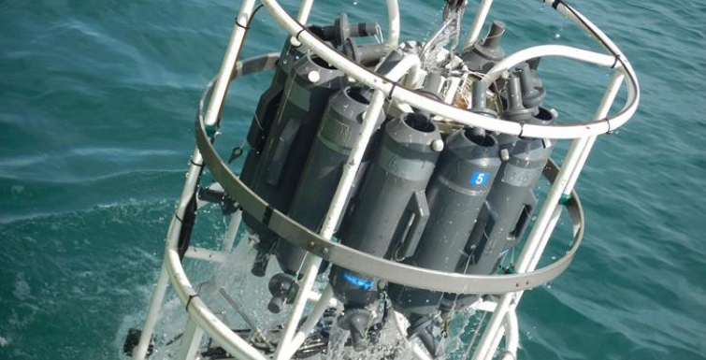
Data Discovery
Data types
Bathymetry
Seabed backscatter
Sea water attributes
Temperature
Salinity
Conductivity
Seismic
Seabed samples

Slide 6
Data Discovery
Questions & Discussion

