Slide 1
South-West Pacific
Hydrographic Commission
Data Discovery
James Miller
National Oceanic and Atmospheric Administration
16th Conference - Alofi, Niue
February 2019

Slide 2
Multiple Overlapping Objectives
Nautical charting
Seabed 2030
Sustainable development goals
Marine spatial planning
Fisheries management
Habitat mapping
Inundation modeling
Disaster planning

Slide 3
Data Discovery Workflow
DISCOVER
Proactively seek available data to meet needs
PRIORITIZE
Prioritize based on navigational safety, ease of review and application
REVIEW
Determine whether it is best available data for charting or other applications
APPLY
Apply to chart
Portray data quality assessment with CATZOC

Slide 4
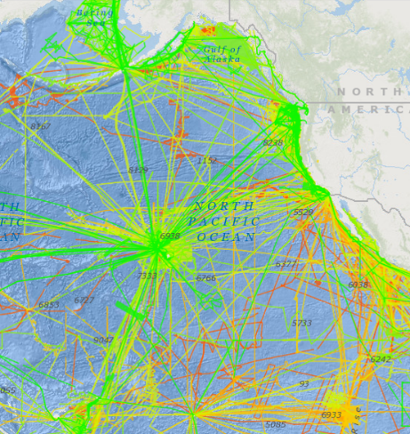
U.S. Data Portals
National Centers for Environmental Information
https://www.ncei.noaa.gov/
Digital Coast
https://coast.noaa.gov/digitalcoast/
Data is publicly available to be used without restriction

Slide 5
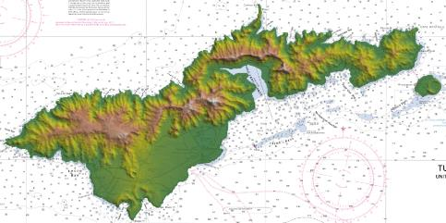
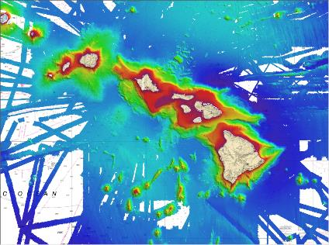
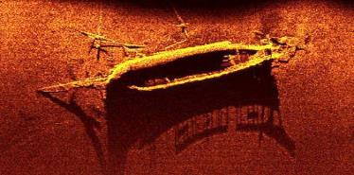
Available Data Types
Lidar
Multibeam
Side scan

Slide 6
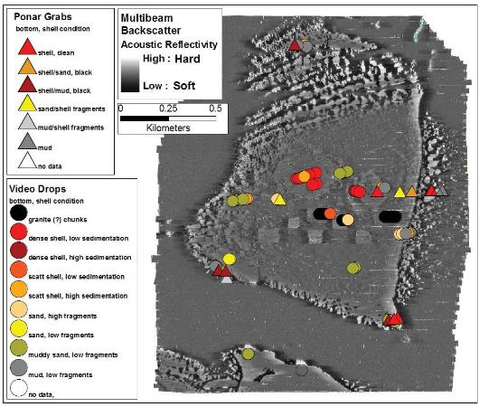
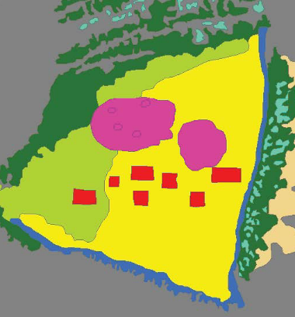
Available Data Types
Acoustic Backscatter

Slide 7
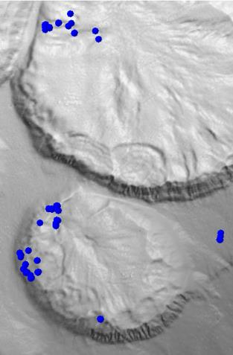
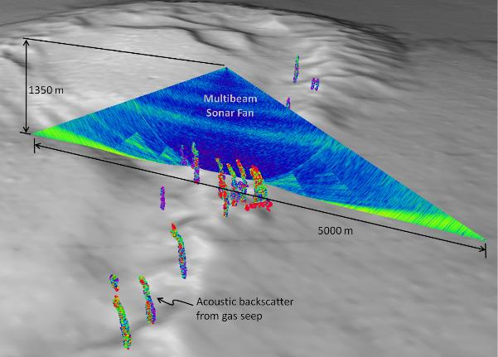
Available Data Types
Water Column

Slide 8
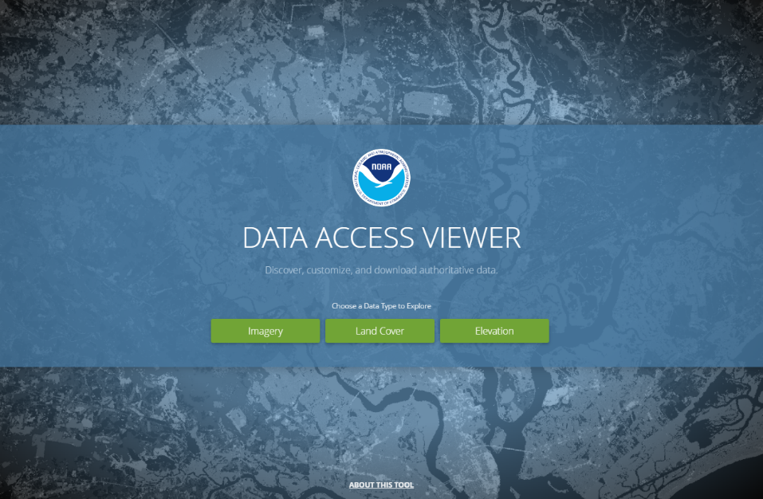
Digital Coast - Lidar Example

Slide 9
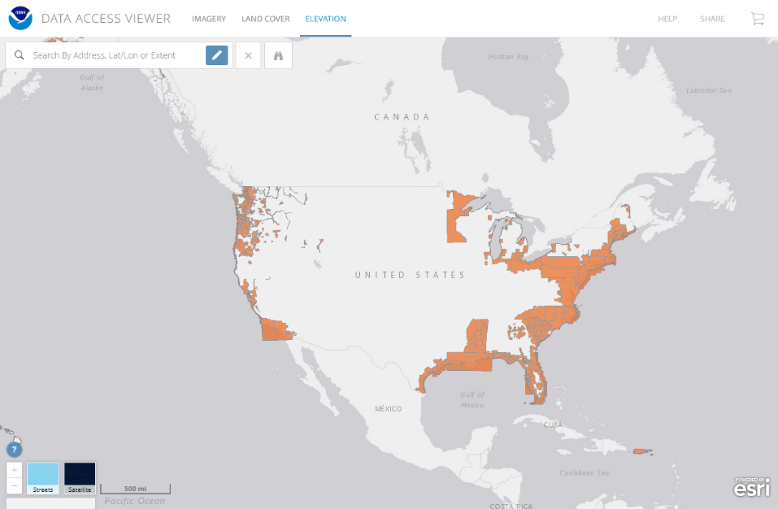
Digital Coast - Lidar Example

Slide 10
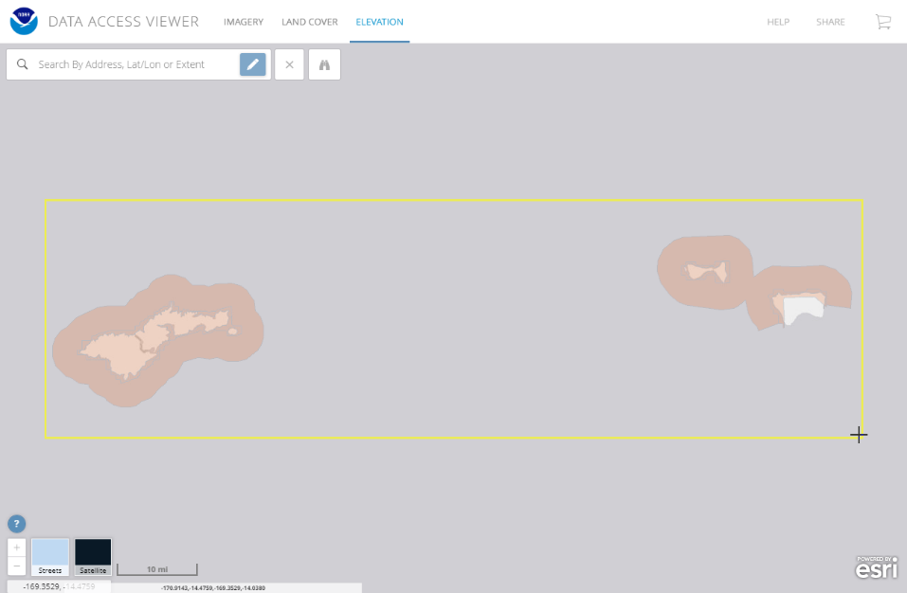
Digital Coast - Lidar Example

Slide 11
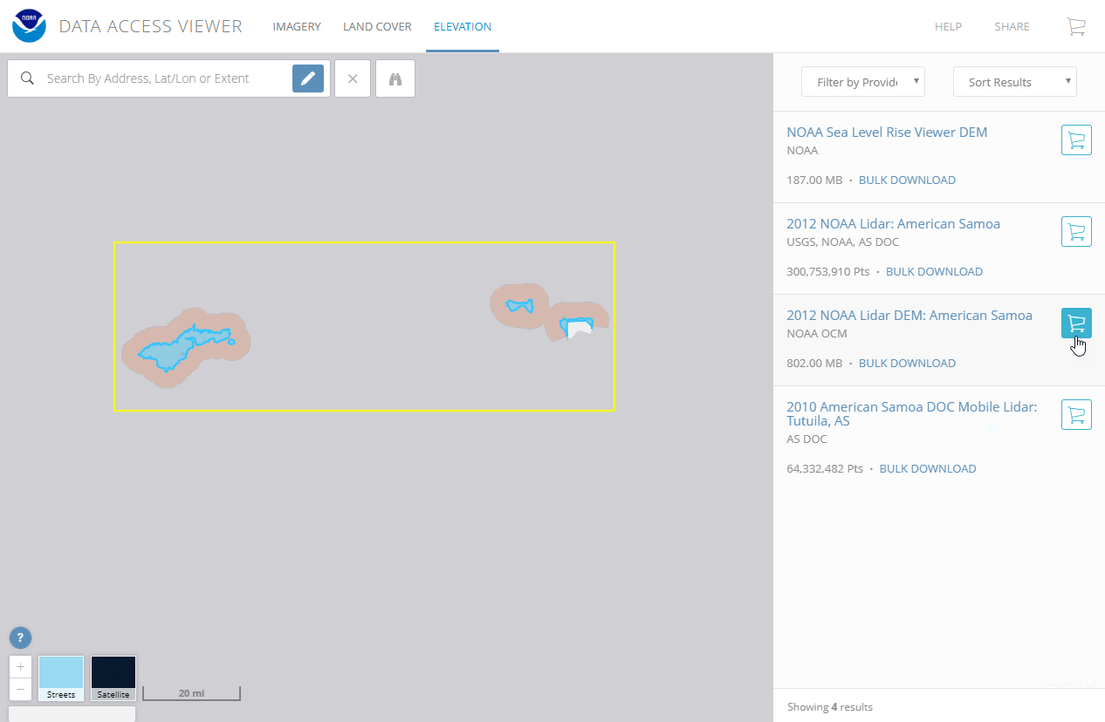
Digital Coast - Lidar Example

Slide 12
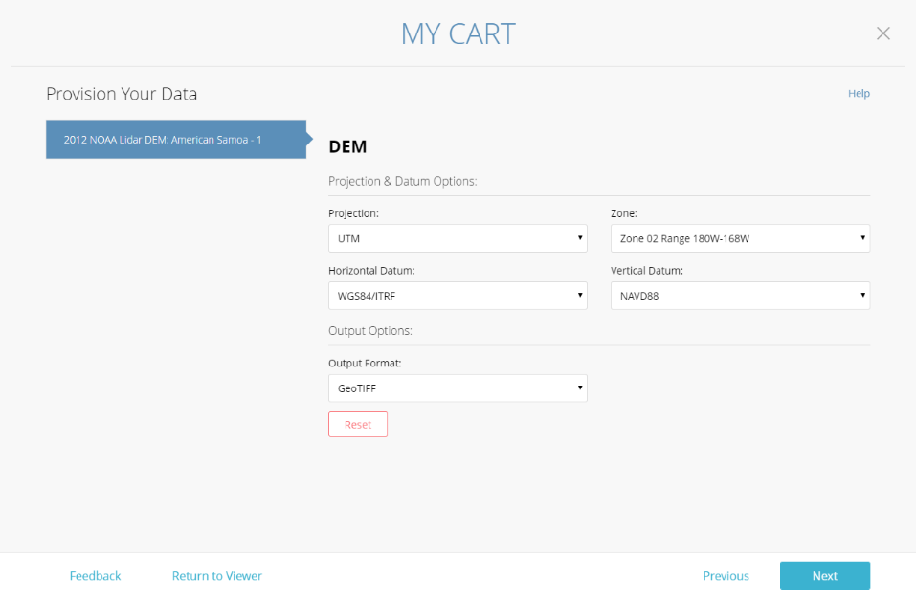
Digital Coast - Lidar Example

Slide 13
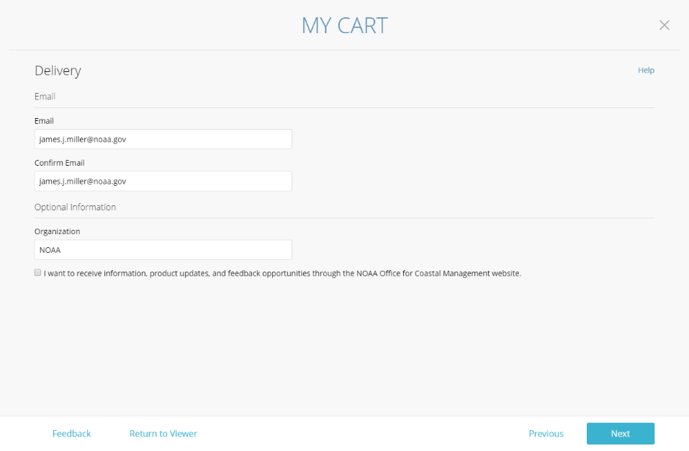
Digital Coast - Lidar Example

Slide 14
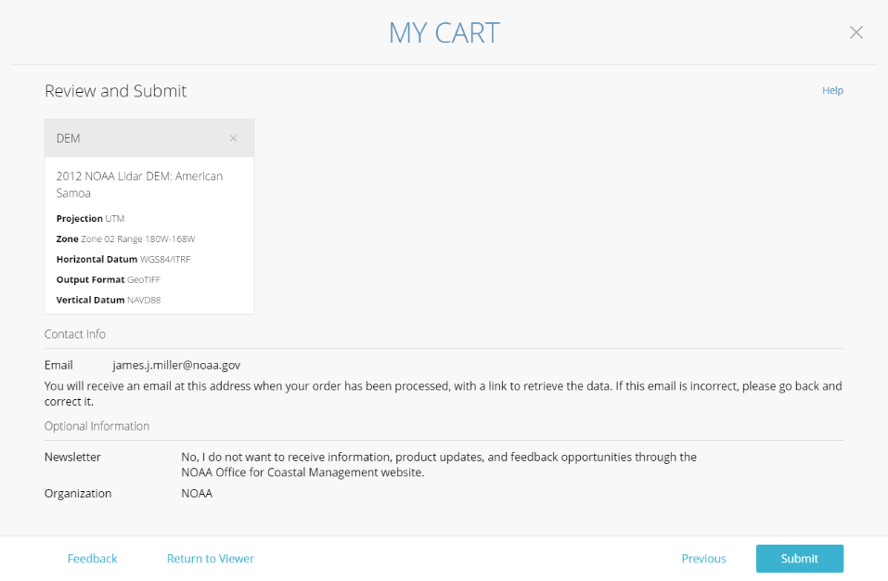
Digital Coast - Lidar Example

Slide 15
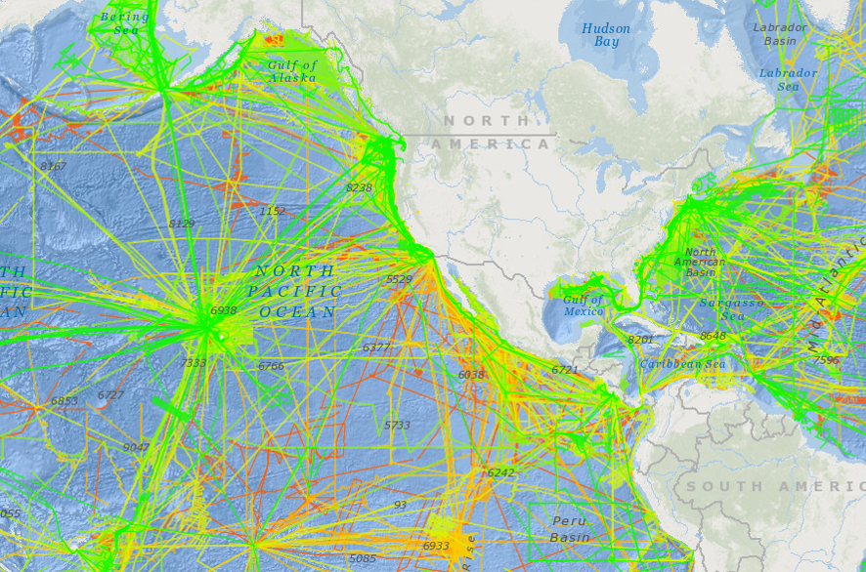
NCEI - Multibeam Example

Slide 16
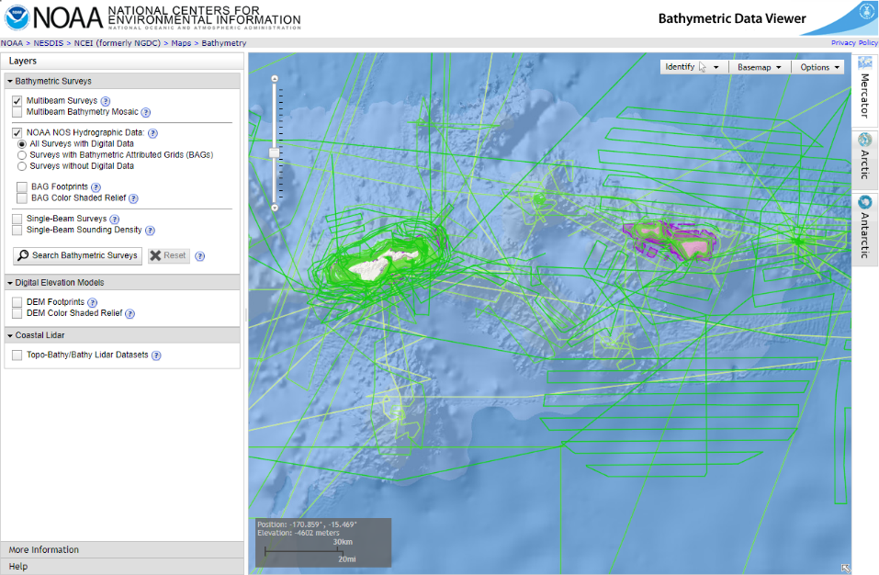
NCEI - Multibeam Example

Slide 17
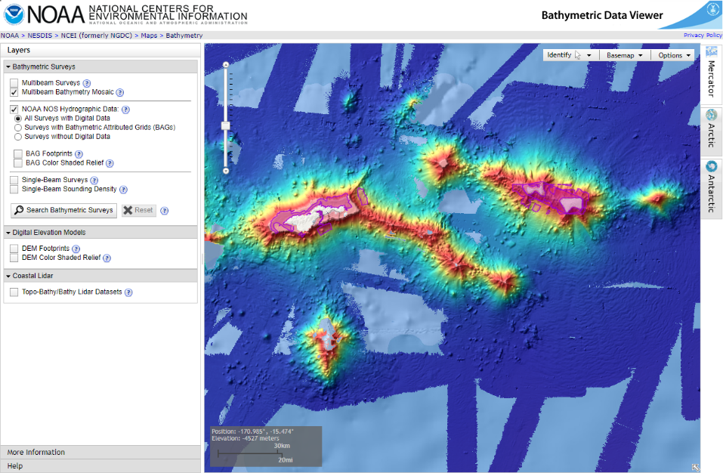
NCEI - Multibeam Example

Slide 18
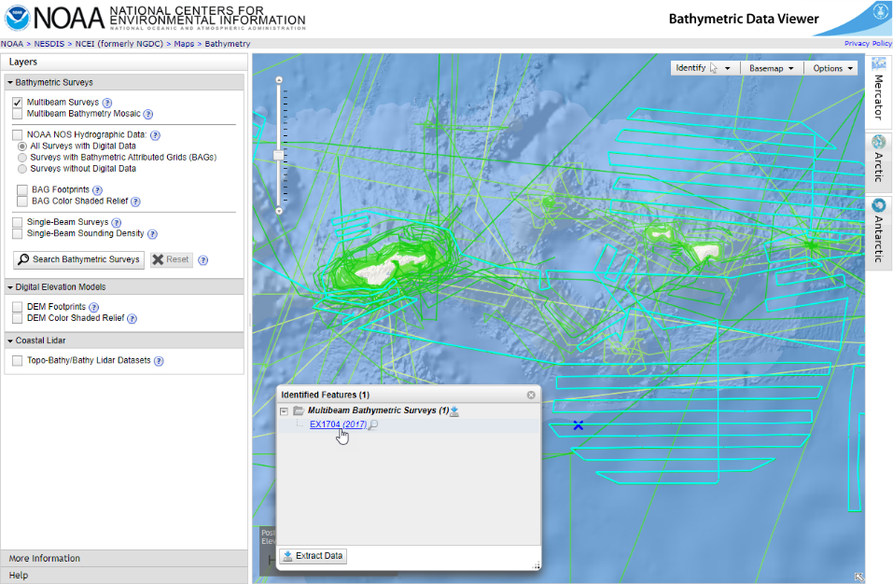
NCEI - Multibeam Example

Slide 19
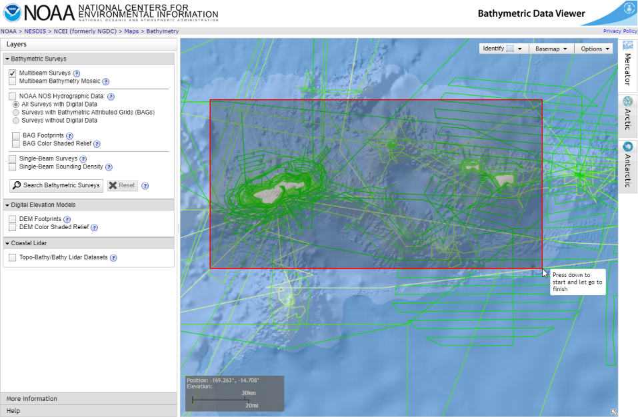
NCEI - Multibeam Example

Slide 20
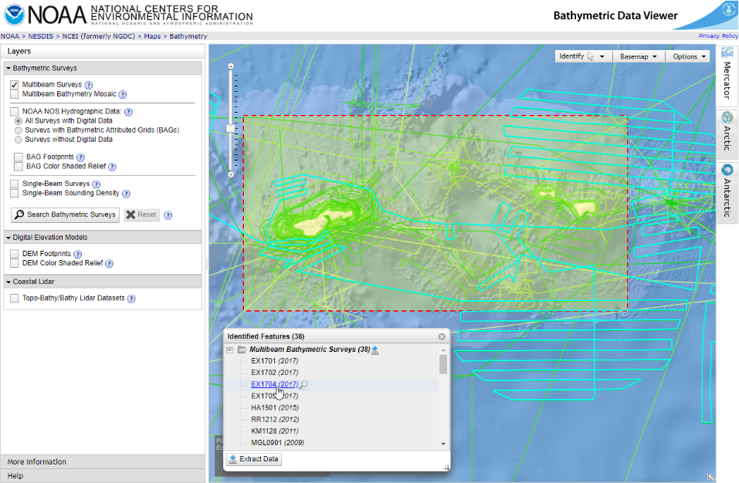
NCEI - Multibeam Example

Slide 21
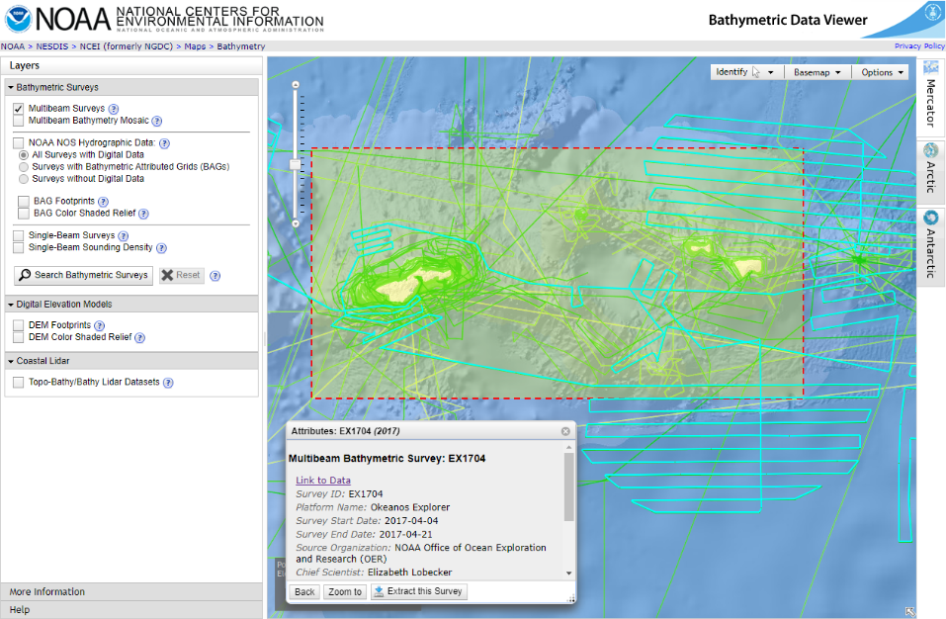
NCEI - Multibeam Example

Slide 22
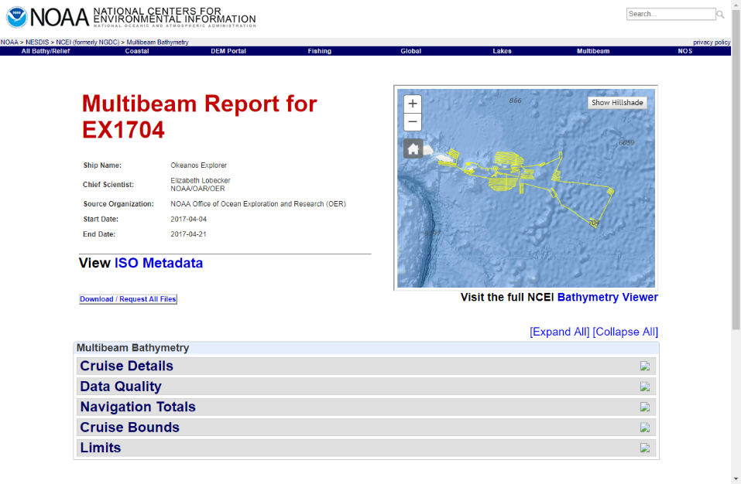
NCEI - Multibeam Example

Slide 23
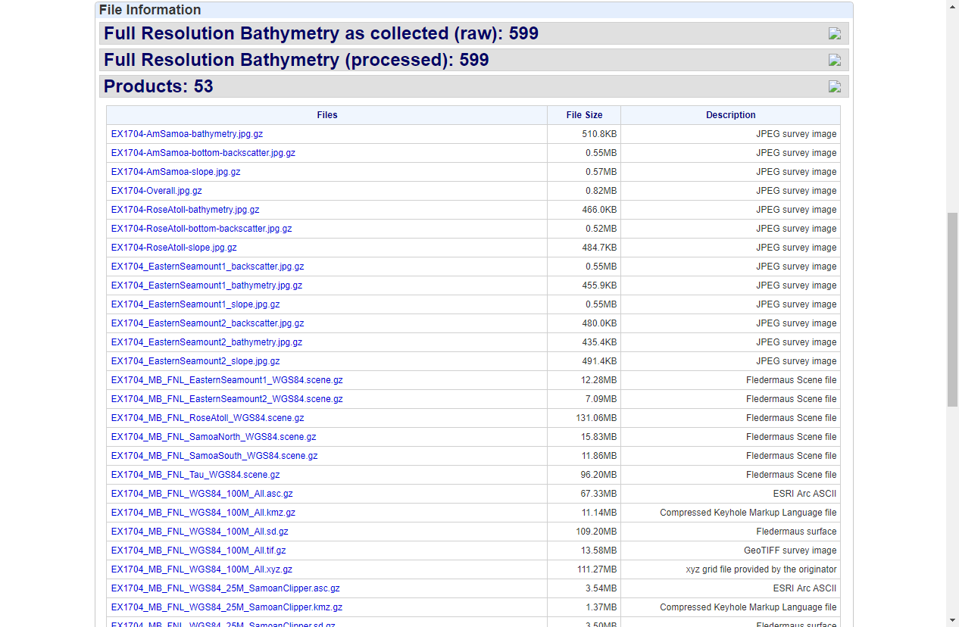
NCEI - Multibeam Example

Slide 24
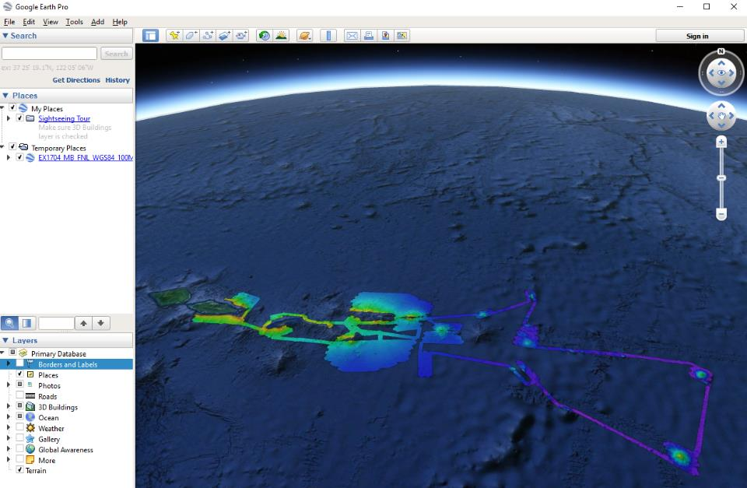
NCEI - Multibeam Example

Slide 25
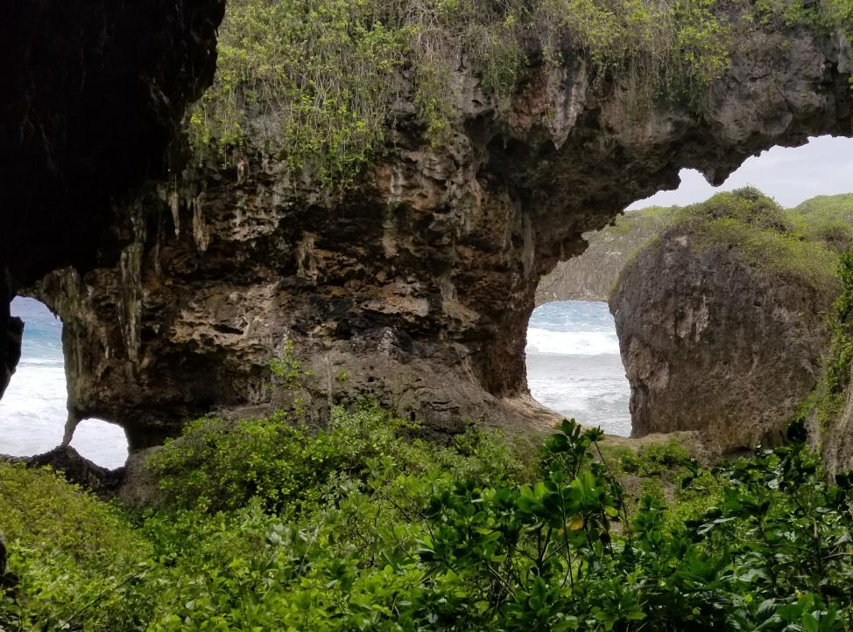
THANK YOU
Contact Information
james.j.miller@noaa.gov

